Slide 1


Android Intents
12
Notes are based on:
Android Developers
http://developer.android.com/index.html

Slide 2
12. Android – Intents
Intents
Android Activities An Android application could include any number of activities.
An activity uses the setContentView(...) method to expose (usually) a single UI from which a number of actions could be performed.
Activities are independent of each other; however they usually cooperate exchanging data and actions.
Typically, one of the activities is designated as the first one (main) that should be presented to the user when the application is launched.
Moving from one activity to another is accomplished by asking the current activity to execute an intent.
Activities interact with each other in an asynchronous mode.
2

Slide 3
12. Android – Intents
Intents
Android Activities
Android Application
Main Activity
results
intents
Sub-Activity-1
Sub-Activity-n
extras
3
3

Slide 4
12. Android – Intents
Intents
Taken from: http://code.google.com/android/reference/android/content/Intent.html
Intents are invoked using the following options
startActivity (intent) | launches an Activity
sendBroadcast (intent) | sends an intent to any interested BroadcastReceiver components
startService(intent) or bindService(intent, …) | communicate with a background Service.
4

Slide 5
12. Android – Intents
Intents
Taken from: http://code.google.com/android/reference/android/content/Intent.html
The main arguments of an Intent are:
Action The built-in action to be performed, such as ACTION_VIEW, ACTION_EDIT, ACTION_MAIN, … or user-created-activity
Data The primary data to operate on, such as a phone number to be called (expressed as a Uri).
Activity-1
Intent: { action + data }
Activity-2
Optional results
5

Slide 6
12. Android – Intents
Intents
Taken from: http://code.google.com/android/reference/android/content/Intent.html
Typically an intent is called as follows:
Intent myActivity = new Intent (action, data);
startActivity (myActivity);
Primary data (as an URI)
tel://
http://
sendto://
Built-in or user-created activity
6
6

Slide 7
12. Android – Intents
Intents
Taken from: http://code.google.com/android/reference/android/content/Intent.html
Examples of action/data pairs are:
ACTION_DIAL tel:123 Display the phone dialer with the given number filled in.
ACTION_VIEW http://www.google.com Show Google page in a browser view. Note how the VIEW action does what is considered the most reasonable thing for a particular URI.
ACTION_EDIT content://contacts/people/2 Edit information about the person whose identifier is "2".
ACTION_VIEW content://contacts/people/2 Used to start an activity to display 2-nd person.
ACTION_VIEW content://contacts/ people/ Display a list of people, which the user can browse through. Selecting a particular person to view would result in a new intent
7

Slide 8
12. Android – Intents
Intents
Built-in Standard Actions
List of standard actions that Intents can use for launching activities (usually through startActivity(Intent).
ACTION_MAIN ACTION_VIEW ACTION_ATTACH_DATA ACTION_EDIT ACTION_PICK ACTION_CHOOSER ACTION_GET_CONTENT ACTION_DIAL ACTION_CALL ACTION_SEND ACTION_SENDTO | ACTION_ANSWER ACTION_INSERT ACTION_DELETE ACTION_RUN ACTION_SYNC ACTION_PICK_ACTIVITY ACTION_SEARCH ACTION_WEB_SEARCH ACTION_FACTORY_TEST
8
8

Slide 9
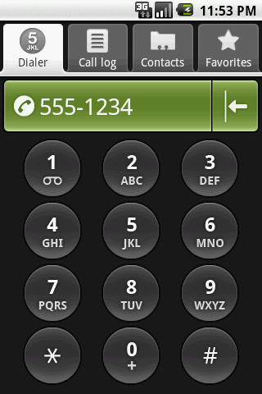
12. Android – Intents
Intents
Taken from: http://code.google.com/android/reference/android/content/Intent.html
Example
Display the phone dialer with the given number filled in.
Intent myActivity2 = new Intent (Intent.ACTION_DIAL, Uri.parse( "tel:555-1234"));
startActivity(myActivity2);
9

Slide 10
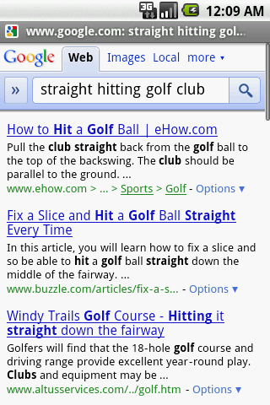
12. Android – Intents
Intents
Taken from: http://code.google.com/android/reference/android/content/Intent.html
Intents - Secondary Attributes In addition to the primary action/data attributes, there are a
number of secondary attributes that you can also include
with an intent, such as:
Category 2. Components
3. Type 4. Extras
Example: Doing a Google search looking for golf clubs
Intent intent = new Intent (Intent.ACTION_WEB_SEARCH );
intent.putExtra(SearchManager.QUERY,
"straight hitting golf clubs");
startActivity(intent);
Secondary data
Apparently the Google answer is ‘none’
10

Slide 11
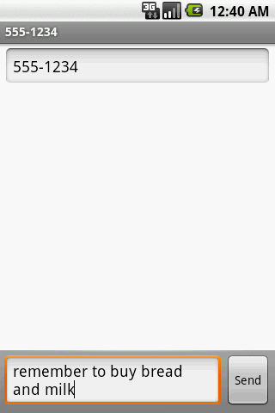
12. Android – Intents
Intents
Taken from: http://code.google.com/android/reference/android/content/Intent.html
Intents - Secondary Attributes
Example: Sending a text message (using extra attributes)
Intent intent = new Intent( Intent.ACTION_SENDTO, Uri.parse("sms:5551234"));
intent.putExtra("sms_body", "are we playing golf next Saturday?");
startActivity(intent);
“address”, “sms_body” are keywords
11

Slide 12
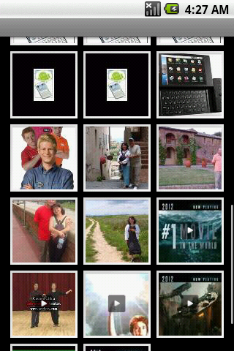
12. Android – Intents
Intents
Taken from: http://code.google.com/android/reference/android/content/Intent.html
Intents - Secondary Attributes
Example: Showing Pictures (using extra attributes)
Intent myIntent = new Intent();
myIntent.setType("image/pictures/*");
myIntent.setAction(Intent.ACTION_GET_CONTENT);
startActivity(myIntent);
12

Slide 13
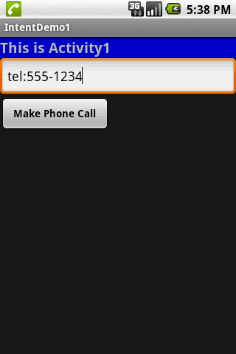
12. Android – Intents
Intents
1. A Complete Example: Activity1 displays an interface to accept a phone number and requests (built-in) Activity2 to make the call.
<?xml version="1.0" encoding="utf-8"?>
<LinearLayout xmlns:android="http://schemas.android.com/apk/res/android"
android:orientation="vertical"
android:layout_width="fill_parent"
android:layout_height="fill_parent" >
<TextView
android:id="@+id/label1"
android:layout_width="fill_parent"
android:layout_height="wrap_content"
android:background="#ff0000cc"
android:text="This is Activity1"
android:textStyle="bold"
android:textSize="20sp" />
<EditText
android:id="@+id/text1"
android:layout_width="fill_parent"
android:layout_height="54px"
android:text="tel:555-1234"
android:textSize="18sp" />
<Button
android:id="@+id/btnCallActivity2"
android:layout_width="149px"
android:layout_height="wrap_content"
android:text="Make Phone Call"
android:textStyle="bold" />
</LinearLayout>
13

Slide 14
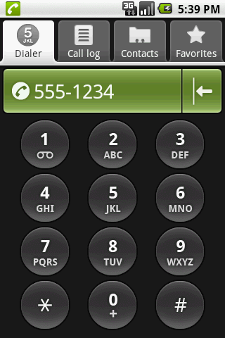
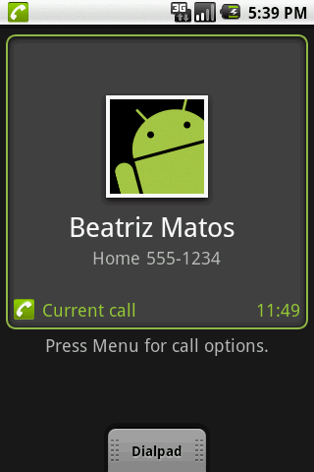
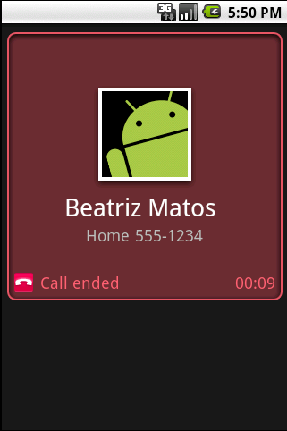
12. Android – Intents
Intents
1. A Complete Example: Activity1 displays an interface to accept a phone number and requests (built-in) Activity2 to make the call.
14

Slide 15
12. Android – Intents
Intents
1. A Complete Example: Activity1 displays an interface to accept a phone number and requests (built-in) Activity2 to make the call.
//IntentDemo1_Intent: making a phone call
package cis493.intents;
import android.app.Activity;
import android.content.Intent;
import android.net.Uri;
import android.os.Bundle;
import android.view.View;
import android.view.View.OnClickListener;
import android.widget.*;
public class IntentDemo1 extends Activity {
TextView label1;
EditText text1;
Button btnCallActivity2;
15

Slide 16
12. Android – Intents
Intents
1. A Complete Example: Activity1 displays an interface to accept a phone number and requests (built-in) Activity2 to make the call.
@Override
public void onCreate(Bundle savedInstanceState) {
super.onCreate(savedInstanceState);
try {
setContentView(R.layout.main);
label1 = (TextView)findViewById(R.id.label1);
text1 = (EditText)findViewById(R.id.text1);
btnCallActivity2 = (Button)findViewById(R.id.btnCallActivity2);
btnCallActivity2.setOnClickListener(new ClickHandler());
}
catch (Exception e) {
Toast.makeText(getBaseContext(), e.getMessage(), Toast.LENGTH_LONG).show();
}
}//onCreate
16

Slide 17
12. Android – Intents
Intents
1. A Complete Example: Activity1 displays an interface to accept a phone number and requests (built-in) Activity2 to make the call.
)
private class ClickHandler implements OnClickListener {
@Override
public void onClick(View v) {
try {
// myActivity2 places a phone call
// for ACTION_CALL or ACTION_DIAL
// use 'tel:' formatted data: "tel:555-1234"
// for ACTION_VIEW use data: "http://www.youtube.com"
// (you also need INTERNET permission - see Manifest)
String myData = text1.getText().toString();
Intent myActivity2 = new Intent(Intent.ACTION_DIAL, Uri.parse(myData));
startActivity(myActivity2);
}
catch (Exception e) {
Toast.makeText(getBaseContext(), e.getMessage(), Toast.LENGTH_LONG).show();
}
}//onClick
}//ClickHandler
}//IntentDemo1
17

Slide 18
12. Android – Intents
Intents
1. A Complete Example: Activity1 displays an interface that accepts from the user a phone number and requests (built-in) Activity2 to make the call.
<?xml version="1.0" encoding="utf-8"?>
<manifest xmlns:android="http://schemas.android.com/apk/res/android"
package="cis493.intents"
android:versionCode="1"
android:versionName="1.0">
<application android:icon="@drawable/icon" android:label="@string/app_name">
<activity android:name=".IntentDemo1“
android:label="@string/app_name">
<intent-filter>
<action android:name="android.intent.action.MAIN" />
<category android:name="android.intent.category.LAUNCHER" />
</intent-filter>
</activity>
</application>
<uses-sdk android:minSdkVersion="3" />
</manifest>
Action/category
18

Slide 19
12. Android – Intents
Intents
Built-in Standard Broadcast Actions
List of standard actions that Intents can use for receiving broadcasts (usually through registerReceiver(BroadcastReceiver, IntentFilter) or a <receiver> tag in a manifest).
ACTION_TIME_TICK ACTION_TIME_CHANGED ACTION_TIMEZONE_CHANGED ACTION_BOOT_COMPLETED ACTION_PACKAGE_ADDED ACTION_PACKAGE_CHANGED ACTION_PACKAGE_REMOVED ACTION_UID_REMOVED ACTION_BATTERY_CHANGED
19

Slide 20
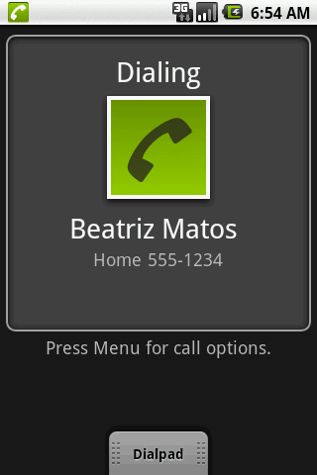
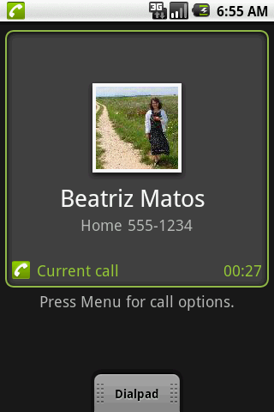
12. Android – Intents
Intents
More Examples: Using Standard Actions
Call Immediately
Modify the complete example1 replacing
the method ‘ClickHandler’ with
the following code
String myData = "tel:555-1234";
Intent myActivity2 = new Intent(Intent.ACTION_CALL,
Uri.parse(myData));
startActivity(myActivity2);
Needs Permission:
<uses-permission android:name="android.permission.CALL_PHONE" />
20

Slide 21
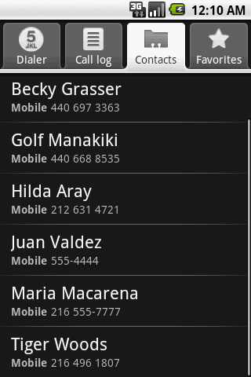
12. Android – Intents
Intents
More Examples: Using Standard Actions
Show all your Contacts
Modify the complete example1 replacing
the method ‘ClickHandler’ with
the following code
String myData = "content://contacts/people/";
Intent myActivity2 = new Intent(Intent.ACTION_VIEW,
Uri.parse(myData));
startActivity(myActivity2);
21

Slide 22
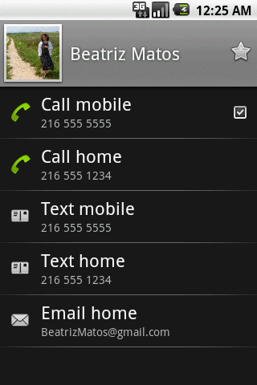
12. Android – Intents
Intents
More Examples: Using Standard Actions
Show a Particular Contact (ID = 2)
Modify the complete example1 replacing
the method ‘ClickHandler’ with
the following code
String myData = "content://contacts/people/2";
Intent myActivity2 = new Intent(Intent.ACTION_VIEW,
Uri.parse(myData));
startActivity(myActivity2);
22

Slide 23
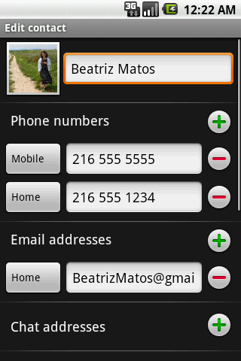
12. Android – Intents
Intents
More Examples: Using Standard Actions
Edit a Particular Contact (ID = 2)
Modify the complete example1 replacing
the method ‘ClickHandler’ with
the following code
String myData = "content://contacts/people/2";
Intent myActivity2 = new Intent(Intent.ACTION_EDIT,
Uri.parse(myData));
startActivity(myActivity2);
23

Slide 24
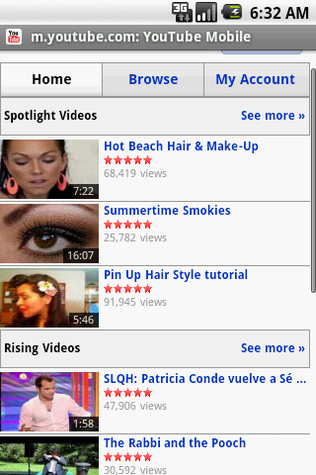
12. Android – Intents
Intents
More Examples: Using Standard Actions
View a Webpage
Modify the complete example1 replacing
the method ‘ClickHandler’ with
the following code
String myData = "http://www.youTube.com";
Intent myActivity2 = new Intent(Intent.ACTION_VIEW,
Uri.parse(myData));
startActivity(myActivity2);
Caution. Add to the Manifest a request to use the Internet:
<uses-permission android:name="android.permission.INTERNET" />
24

Slide 25
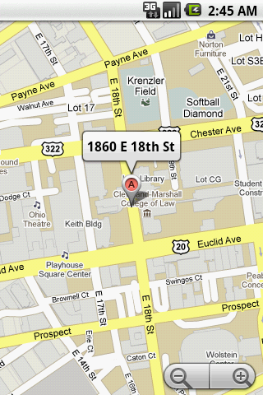
12. Android – Intents
Intents
More Examples: Using Standard Actions
Geo Mapping an Address
Provide a geoCode expression holding a street
address (or place, such as ‘golden gate ca’ )
Replace spaces with ‘+’.
String geoCode =
"geo:0,0?q=1860+east+18th+street+cleveland+oh";
Intent intent = new Intent(Intent.ACTION_VIEW,
Uri.parse(geoCode));
startActivity(intent);
Modify the Manifest adding the following requests:
<uses-permission android:name="android.permission.ACCESS_COARSE_LOCATION" />
<uses-permission android:name="android.permission.INTERNET" />
25

Slide 26
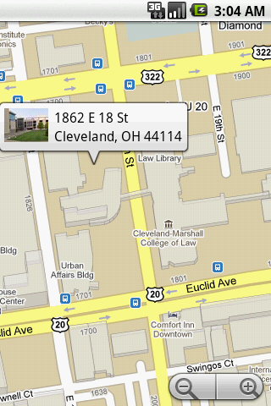
12. Android – Intents
Intents
More Examples: Using Standard Actions
Geo Mapping Coordinates (latitude, longitude)
Provide a geoCode holding latitude and
longitude (also an addittional zoom ‘?z=xx’ with
xx in range 1..23)
String geoCode =
"geo:41.5020952,-81.6789717";
Intent intent = new Intent(Intent.ACTION_VIEW,
Uri.parse(geoCode));
startActivity(intent);
Modify the Manifest adding the following requests:
<uses-permission android:name="android.permission.ACCESS_COARSE_LOCATION" />
<uses-permission android:name="android.permission.INTERNET" />
26

Slide 27
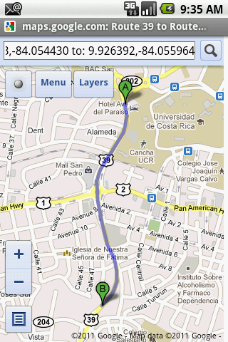
12. Android – Intents
Intents
More Examples
// Getting driving directions: how to go from loaction A to location B?
Intent intent = new Intent(android.content.Intent.ACTION_VIEW,
Uri.parse("http://maps.google.com/maps?saddr=9.938083,-84.054430&daddr=9.926392,-84.055964"));
startActivity(intent);

Slide 28
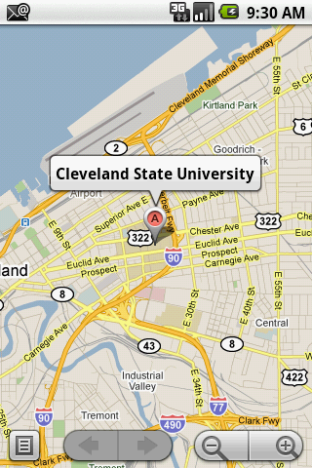
12. Android – Intents
Intents
More Examples
// use a mnemonic to articulate an address
String thePlace = “Cleveland State University”;
Intent intent = new Intent(android.content.Intent.ACTION_VIEW,
Uri.parse("geo:0,0?q= (" + thePlace + ")“ ); startActivity(intent);

Slide 29
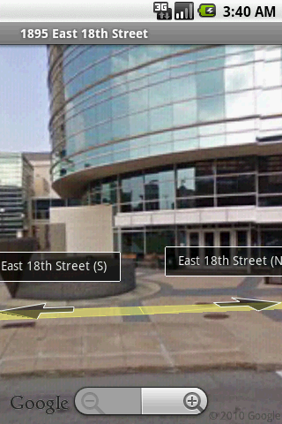
12. Android – Intents
Intents
More Examples: Using Standard Actions
Geo Mapping - Google StreetView
geoCode Uri structure:
google.streetview:cbll=lat,lng&cbp=1,
yaw,,pitch,zoom&mz=mapZoom
Reference: http://developer.android.com/guide/appendix/g-app-intents.html
String geoCode =
"google.streetview:cbll=41.5020952,-81.6789717&cbp=1,270,,45,1&mz=1";
Intent intent = new Intent(Intent.ACTION_VIEW,
Uri.parse(geoCode));
startActivity(intent);
Modify the Manifest adding the following requests:
<uses-permission android:name="android.permission.ACCESS_COARSE_LOCATION" />
<uses-permission android:name="android.permission.INTERNET" />
29

Slide 30
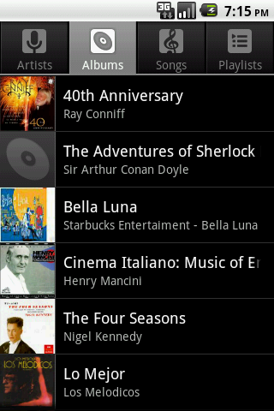
12. Android – Intents
Intents
More Examples: Using Standard Actions
Launching the Music Player
Reference: http://developer.android.com/guide/appendix/g-app-intents.html
//launch music player
Intent myActivity2 =
new Intent("android.intent.action.MUSIC_PLAYER");
startActivity(myActivity2);
30

Slide 31
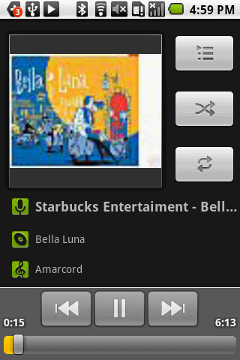
12. Android – Intents
Intents
More Examples: Using Standard Actions
Playing a song stored in the SD card
Reference: http://developer.android.com/guide/appendix/g-app-intents.html
// play song "amarcord.mp3" saved in the SD
Intent myActivity2 =
new Intent(android.content.Intent.ACTION_VIEW);
Uri data = Uri.parse("file:///sdcard/amarcord.mp3");
String type = "audio/mp3";
myActivity2.setDataAndType(data, type);
startActivity(myActivity2);
31

Slide 32
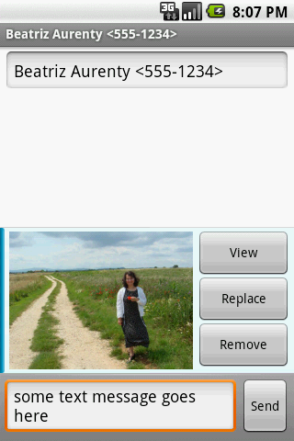
12. Android – Intents
Intents
More Examples: Using Standard Actions
Sending MMS
Add picture #1 from SD to MMS
Reference: http://developer.android.com/guide/appendix/g-app-intents.html
//send mms attach picture #1 to it
Uri uri = Uri.parse("content://media/external/images/media/1");
myActivity2 = new Intent(Intent.ACTION_SEND);
myActivity2.putExtra("address", "555-1234");
myActivity2.putExtra("sms_body", "some text message goes here");
myActivity2.putExtra(Intent.EXTRA_STREAM, uri);
myActivity2.setType("image/png");
startActivity(myActivity2);
32

Slide 33
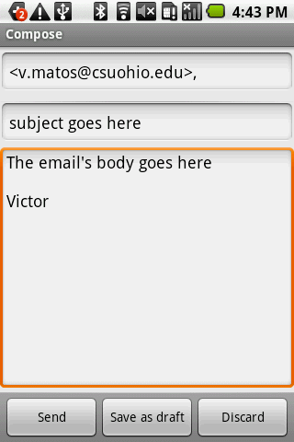
12. Android – Intents
Intents
More Examples: Using Standard Actions
Sending Email
Reference: http://developer.android.com/guide/appendix/g-app-intents.html
// send email
Uri uri = Uri.parse("mailto:v.matos@csuohio.edu");
Intent myActivity2 = new Intent(Intent.ACTION_SENDTO, uri);
// you may skip the next two pieces [subject/text]
myActivity2.putExtra(Intent.EXTRA_SUBJECT,
"subject goes here");
myActivity2.putExtra(Intent.EXTRA_TEXT,
"The email's body goes here");
startActivity(myActivity2);
33

Slide 34
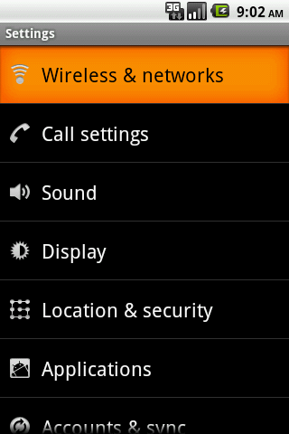
12. Android – Intents
Intents
More Examples: Using Standard Actions
Setting System
Reference: http://developer.android.com/reference/android/provider/Settings.html
Intent intent = new Intent(
android.provider.Settings.ACTION_SETTINGS);
startActivity(intent);
34

Slide 35
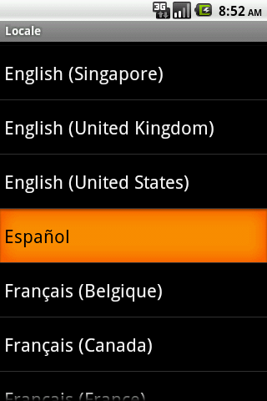
12. Android – Intents
Intents
More Examples: Using Standard Actions
Setting System Locale:
Language & Keyboard
Reference: http://developer.android.com/reference/android/provider/Settings.html
Intent intent = new Intent(
android.provider.Settings.ACTION_LOCALE_SETTINGS);
startActivity(intent);
35

Slide 36
12. Android – Intents
Intents
Starting Activities and Getting Results
The startActivity(Intent) method is used to start a new activity, which will be placed at the top of the activity stack.
Sometimes you want to get a result back
from the called sub-activity when it ends.
For example, you may start an activity that let the user pick a person from a list of contacts; when it ends, it returns the person that was selected.
36

Slide 37
12. Android – Intents
Intents
Starting Activities and Getting Results
In order to get results back from the called activity we use the method
startActivityForResult ( Intent, requestCodeID )
Where the second (requestCodeID) parameter identifies the call.
The result sent by the sub-activity could be picked up through the asynchronous method
onActivityResult ( requestCodeID, resultCode, Intent )
37

Slide 38
12. Android – Intents
Intents
Starting Activities and Getting Results
Before an activity exits, it can call setResult (resultCode)
to return a termination signal back to its parent.
Always supply a result code, which can be the standard results Activity.RESULT_CANCELED, Activity.RESULT_OK,
or any custom values.
All of this information can be capture back on the parent's
onActivityResult (int requestCodeID, int resultCode, Intent data)
along with the integer identifier it originally supplied.
If a child activity fails for any reason (such as crashing), the parent activity will receive a result with the code RESULT_CANCELED.
38

Slide 39
12. Android – Intents
Intents
Starting Activities and Getting Results
Intent: {action + data + requestCodeID }
Activity-1
startActivityForResult
…
…
__________________
onActivityResult()
…
…
Activity-2
_________________
onResult()
…
…
requestCodeID
resultCode
optional data
39

Slide 40
12. Android – Intents
Intents
Example2. Let’s play golf - Call for a tee-time.
Show all contacts and pick a particular one (Intent.ACTION_PICK).
For a successful interaction the main-activity accepts the returned URI identifying the person we want to call (content://contacts/people/n).
‘Nicely’ show the selected contact’s entry allowing calling, texting, emailing actions (Intent.ACTION_VIEW).
Intent.ACTION_PICK
User’s main
Activity-1
Built-in Activity-2
(show contact list)
Contact’s Uri
Intent.ACTION_VIEW
Call
Send text message
Send email
Built-in Activity-3
(show selected contact)
40

Slide 41
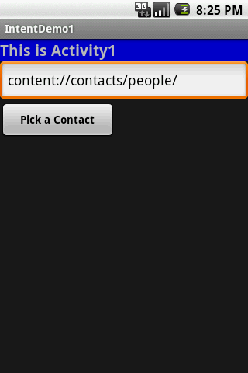
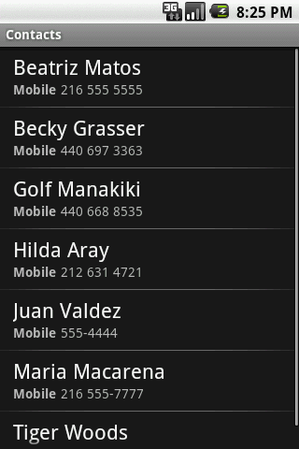
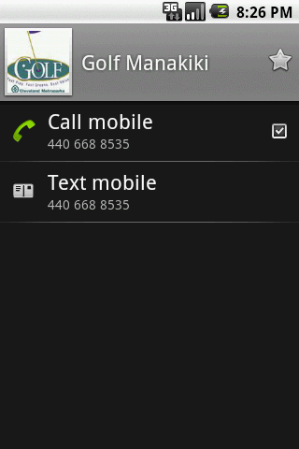
12. Android – Intents
Intents
Example2. Let’s play golf - Call for a tee-time.
Cont.
Main Activity
Intent.ACTION_PICK
Intent.ACTION_VIEW
41

Slide 42
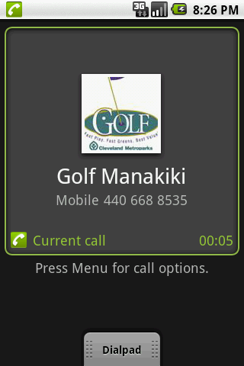
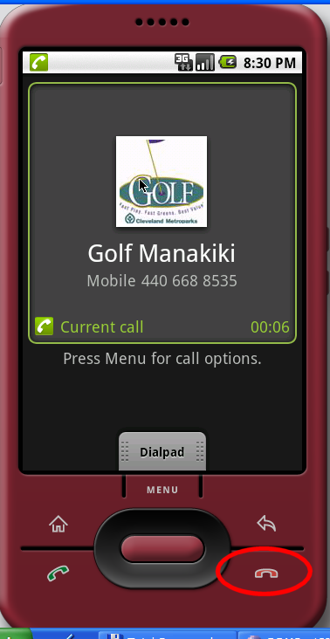
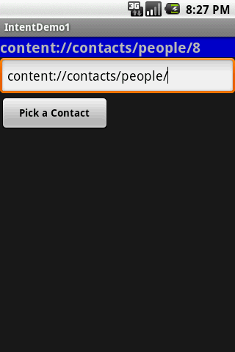
12. Android – Intents
Intents
Example2 (cont.) Let’s play golf - Call for a tee-time
42
Place the call
Terminate the call
Selected contact’s URI

Slide 43
12. Android – Intents
Intents
Example2. Calling a sub-activity, receiving results.
//IntentDemo2_Intent: making a phone call
//receiving results from a sub-activity
package cis493.intents;
import android.app.Activity;
import android.content.Intent;
import android.net.Uri;
import android.os.Bundle;
import android.view.View;
import android.view.View.OnClickListener;
import android.widget.*;
public class IntentDemo2 extends Activity {
TextView label1;
EditText text1;
Button btnCallActivity2;
43

Slide 44
12. Android – Intents
Intents
Example2. Calling a sub-activity, receiving results.
@Override
public void onCreate(Bundle savedInstanceState) {
super.onCreate(savedInstanceState);
try {
setContentView(R.layout.main);
label1 = (TextView)findViewById(R.id.label1);
text1 = (EditText)findViewById(R.id.text1);
btnCallActivity2 = (Button)findViewById(R.id.btnPickContact);
btnCallActivity2.setOnClickListener(new ClickHandler());
}
catch (Exception e) {
Toast.makeText(getBaseContext(),
e.getMessage(), Toast.LENGTH_LONG).show();
}
}//onCreate
44

Slide 45
12. Android – Intents
Intents
Example2. Calling a sub-activity, receiving results.
private class ClickHandler implements OnClickListener {
@Override
public void onClick(View v) {
try {
// myData refer to: content://contacts/people/
String myData = text1.getText().toString();
//you may also try ACTION_VIEW instead
Intent myActivity2 = new Intent(Intent.ACTION_PICK,
Uri.parse(myData));
// start myActivity2.
// Tell it that our requestCodeID (or nickname) is 222
startActivityForResult(myActivity2, 222);
// Toast.makeText(getApplicationContext(),
// "I can't wait for you", 1).show();
}
catch (Exception e) {
label1.setText(e.getMessage());
}
}//onClick
}//ClickHandler
45

Slide 46
12. Android – Intents
Intents
Example2. Calling a sub-activity, receiving results.
@Override
protected void onActivityResult(int requestCode,
int resultCode,
Intent data) {
super.onActivityResult(requestCode, resultCode, data);
try {
// use requestCode to find out who is talking back to us
switch (requestCode){
case (222): {
// 222 is our friendly contact-picker activity
if (resultCode == Activity.RESULT_OK) {
String selectedContact = data.getDataString();
// it will return an URI that looks like:
// content://contacts/people/n
// where n is the selected contacts' ID
label1.setText(selectedContact.toString());
//show a 'nice' screen with the selected contact
Intent myAct3 = new Intent (Intent.ACTION_VIEW,
Uri.parse(selectedContact));
startActivity(myAct3);
}
Listener
46

Slide 47
12. Android – Intents
Intents
Example2. Calling a sub-activity, receiving results.
else {
//user pressed the BACK button
label1.setText("Selection CANCELLED "
+ requestCode + " " + resultCode);
}
break;
}
}//switch
}
catch (Exception e) {
Toast.makeText(getBaseContext(), e.getMessage(), Toast.LENGTH_LONG).show();
}
}// onActivityResult
}//IntentDemo2
47

Slide 48
12. Android – Intents
Intents
Example2. Calling a sub-activity, receiving results.
<?xml version="1.0" encoding="utf-8"?>
<LinearLayout xmlns:android="http://schemas.android.com/apk/res/android"
android:orientation="vertical"
android:layout_width="fill_parent"
android:layout_height="fill_parent“ >
<TextView
android:id="@+id/label1"
android:layout_width="fill_parent"
android:layout_height="wrap_content"
android:background="#ff0000cc"
android:text="This is Activity1"
android:textStyle="bold"
android:textSize="20sp“/>
<EditText
android:id="@+id/text1"
android:layout_width="fill_parent"
android:layout_height="54px"
android:text="content://contacts/people/"
android:textSize="18sp” />
<Button
android:id="@+id/btnPickContact"
android:layout_width="149px"
android:layout_height="wrap_content"
android:text="Pick a Contact"
android:textStyle="bold“ />
</LinearLayout>
48

Slide 49
12. Android – Intents
Intents
Example3. Showing Pictures and Video - Calling a sub-activity, receiving results.
private void showSoundTracks() {
Intent myIntent = new Intent();
myIntent.setType("video/*, images/*");
myIntent.setAction(Intent.ACTION_GET_CONTENT);
startActivityForResult(myIntent, 0);
}//showSoundTracks
@Override
protected void onActivityResult(int requestCode, int resultCode, Intent intent) {
super.onActivityResult(requestCode, resultCode, intent);
if ((requestCode == 0) && (resultCode == Activity.RESULT_OK)) {
String selectedImage = intent.getDataString();
Toast.makeText(this, selectedImage, 1).show();
// show a 'nice' screen with the selected image
Intent myAct3 = new Intent(Intent.ACTION_VIEW, Uri.parse(selectedImage));
startActivity(myAct3);
}
}//onActivityResult
All videos and all still images
49

Slide 50
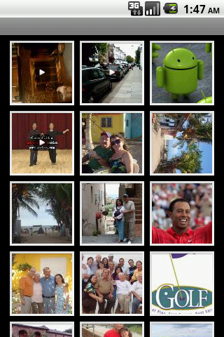
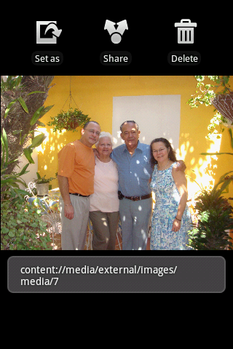
12. Android – Intents
Intents
Example3. Showing Pictures and Video - Calling a sub-activity, receiving results.
video
50

Slide 51
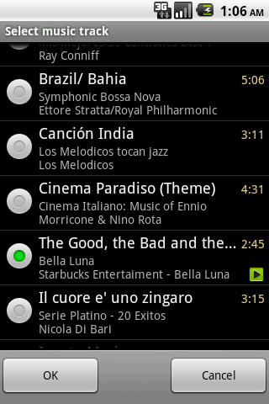

12. Android – Intents
Intents
Example4. Showing/Playing Sound Tracks - Calling a sub-activity, receiving results.
private void showSoundTracks() {
Intent myIntent = new Intent();
myIntent.setType("audio/mp3");
myIntent.setAction(Intent.ACTION_GET_CONTENT);
startActivityForResult(myIntent, 0);
}//showSoundTracks
The returned string value is similar to the following
“content://media/external/audio/media/14”
ACTION_VIEW on that Uri would produce a result
similar to the image on the right
51

Slide 52
12. Android – Intents
Intents
Questions ?
52
52

Slide 53
12. Android – Intents
Intents
Built-in Standard Broadcast Actions
List of standard actions that Intents can use for receiving broadcasts (usually through registerReceiver(BroadcastReceiver, IntentFilter) or a <receiver> tag in a manifest).
ACTION_TIME_TICK ACTION_TIME_CHANGED ACTION_TIMEZONE_CHANGED ACTION_BOOT_COMPLETED ACTION_PACKAGE_ADDED ACTION_PACKAGE_CHANGED ACTION_PACKAGE_REMOVED ACTION_UID_REMOVED ACTION_BATTERY_CHANGED
53
53

Slide 54
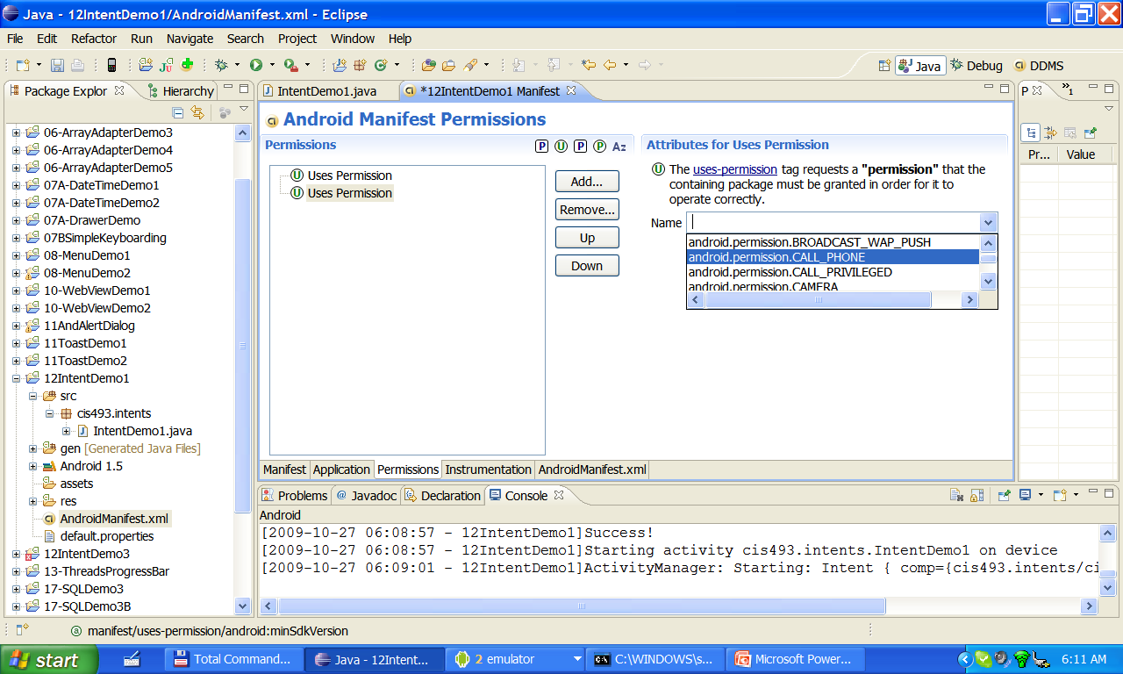
12. Android – Intents
Intents
Appendix: Getting Permissions
Becomes:
<uses-permission android:name="android.permission.CALL_PHONE"></uses-permission>
54
54

Slide 55
Android Intents Part 2 Inter-Process Communication Using Bundles
12-2
Notes are based on:
Android Developers
http://developer.android.com/index.html

Slide 56
12. Android – Intents – Part 2
Intents
Android Intents An activity usually presents a single visual user interface from which a number of actions could be performed.
Moving from one activity to another is accomplished by having the current activity start the next one through so called intents.
Activity-1
startActivityForResult
…
onActivityResult()
…
Intent
{action + data}
Activity-2
onResult()
…
…
requestCode
requestResult
[ optional data ]
56

Slide 57
12. Android – Intents – Part 2
Intents
Android Bundles
Most programming languages support the notion of IPC method-calling with arguments flowing birectionally from the caller to the invoked method.
In android the calling activity issues an invocation to another activity using an Intent object.
Notably in Android, the caller does not stop waiting for the called activity to return results. Instead a listening-method [onActivityResult(...) ] should be used.
57
IPC Inter-Process Communication

Slide 58
12. Android – Intents – Part 2
Intents
Android Bundles
Normally the IPC expressions actual parameter list, and
formal parameter list are used to designated the signature of particpating arguments, and the currently supplied data.
Instead of using the traditional formal / actual parameter lists, Android relies on the concept of Intents to establish Inter-process-communication.
Intents optionally carry a named actual list or bundle for data exchange.
58

Slide 59
12. Android – Intents – Part 2
Intents
Android Bundles
The Android Bundle container is a simple mechanism used to pass data between activities.
A Bundle is a type-safe collection of <name, value> pairs.
There is a set of putXXX and getXXX methods to store and retrieve (single and array) values of primitive data types from/to the bundles. For example
Bundle myBundle = new Bundle();
myBundle.putDouble (“var1”, 3.1415);
...
Double v1 = myBundle.getDouble(“var1”);
59

Slide 60

12. Android – Intents – Part 2
Intents
Android Intents & Bundles
Activity1: Sender
Activity2: Receiver
Intent myIntentA1A2 = new Intent (Activity1.this, Activity2.class);
Bundle myBundle1 = new Bundle();
myBundle1.putInt (“val1”, 123);
myIntentA1A2.putExtras(myBundle1);
startActivityForResult(myIntentA1A2, 1122);
INTENT
Sender class / Receiver class
requestCode (1122)
resultCode
Extras: { val1 = 123 }
60

Slide 61
12. Android – Intents – Part 2
Intents
Android Intents & Bundles
Activity1: Sender
Activity2: Receiver
Intent myLocalIntent2 = getIntent();
Bundle myBundle = myLocalIntent.getExtras();
int val1 = myBundle.getInt(“val1");
INTENT
Sender class / Receiver class
requestCode (1122)
resultCode
Extras: { val1 = 123 }
61

Slide 62
12. Android – Intents – Part 2
Intents
Android Intents & Bundles
Activity1: Sender
Activity2: Receiver
myBundle.putString("val1", 456 );
myLocalIntent.putExtras(myBundle);
setResult(Activity.RESULT_OK, myLocalIntent);
INTENT
Sender class / Receiver class
requestCode (1122)
resultCode (OK)
Extras: { val1 = 456 }
62

Slide 63
12. Android – Intents – Part 2
Intents
Android Bundles Available at: http://developer.android.com/reference/android/os/Bundle.html
63

Slide 64
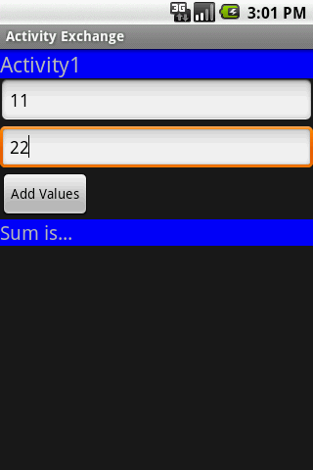
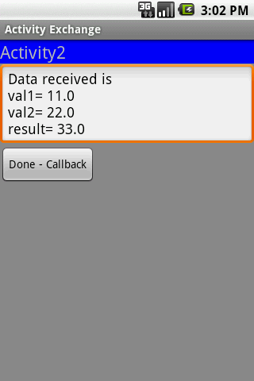
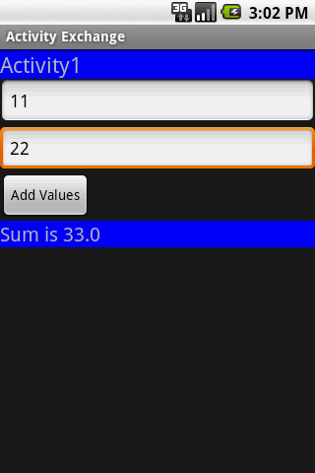
12. Android – Intents – Part 2
Intents
Tutorial. Activity Excahange
Activity1 collects two values from its UI and calls Activity2 to compute the sum of them. The result is sent back from Activity 2 to Activity1.
64

Slide 65
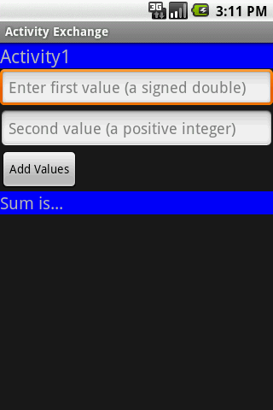
12. Android – Intents – Part 2
Intents
Tutorial. Activity Excahange
Step1. Create GUI for Activity1(main1.xml)
<?xml version="1.0" encoding="utf-8"?>
<LinearLayout xmlns:android="http://schemas.android.com/apk/res/android"
android:orientation="vertical" android:layout_width="fill_parent"
android:layout_height="fill_parent" >
<TextView
android:text="Activity1"
android:textSize="22sp"
android:background="#ff0000ff"
android:layout_width="fill_parent"
android:layout_height="wrap_content" />
<EditText
android:hint="Enter first value (a signed double)"
android:id="@+id/EditText01"
android:layout_width="fill_parent"
android:layout_height="wrap_content"
android:inputType="numberDecimal|numberSigned|number" />
<EditText
android:hint="Second value (a positive integer)"
android:id="@+id/EditText02"
android:layout_width="fill_parent"
android:layout_height="wrap_content"
android:inputType="number" />
<Button
android:text="Add Values"
android:id="@+id/btnAdd"
android:layout_width="wrap_content"
android:layout_height="wrap_content" />
<TextView
android:background="#ff0000ff"
android:text="Sum is..."
android:textSize="28sp"
android:id="@+id/TextView01"
android:layout_width="fill_parent"
android:layout_height="wrap_content" />
</LinearLayout>
Note. The element android:inputStyle indicates the first value could be numeric, with optional decimals and sign.
65

Slide 66
12. Android – Intents – Part 2
Intents
Tutorial. Activity Excahange
Step2. Create GUI for Activity2(main2.xml)
<?xml version="1.0" encoding="utf-8"?>
<LinearLayout xmlns:android="http://schemas.android.com/apk/res/android"
android:orientation="vertical"
android:layout_width="fill_parent"
android:layout_height="fill_parent"
android:background="#ff888888">
<TextView
android:text="Activity2"
android:textSize="22sp"
android:background="#ff0000ff"
android:layout_width="fill_parent"
android:layout_height="wrap_content" />
<EditText
android:text="Data reveived..."
android:id="@+id/etDataReceived"
android:layout_width="fill_parent"
android:layout_height="wrap_content" />
<Button
android:text="Done - Callback"
android:id="@+id/btnDone"
android:layout_width="wrap_content"
android:layout_height="wrap_content" />
</LinearLayout>
66

Slide 67
12. Android – Intents – Part 2
Intents
Tutorial. Activity Excahange
Step3. Activity1. After clicking the button data, from UI is put in a bundle and sent to Activity2. A listener remains alert waiting for results to come from the called activity.
package cis493.matos.intents6;
// Activity1
// get input data from user, call Activity2, show result
import android.app.Activity;
import android.content.Intent;
import android.os.Bundle;
import android.view.View;
import android.view.View.OnClickListener;
import android.widget.Button;
import android.widget.EditText;
import android.widget.TextView;
public class Activity1 extends Activity {
EditText txtVal1;
EditText txtVal2;
TextView lblResult;
Button btnAdd;
@Override
public void onCreate(Bundle savedInstanceState) {
super.onCreate(savedInstanceState);
setContentView(R.layout.main1);
txtVal1 = (EditText)findViewById(R.id.EditText01);
txtVal2 = (EditText)findViewById(R.id.EditText02);
lblResult = (TextView) findViewById(R.id.TextView01);
btnAdd = (Button) findViewById(R.id.btnAdd);
btnAdd.setOnClickListener(new OnClickListener() {
@Override
public void onClick(View v) {
// get values from the UI
Double v1 = Double.parseDouble(txtVal1.getText().toString());
Double v2 = Double.parseDouble(txtVal2.getText().toString());
// create intent to call Activity2
Intent myIntentA1A2 = new Intent (Activity1.this,
Activity2.class);
// create a container to ship data
Bundle myData = new Bundle();
// add <key,value> data items to the container
myData.putDouble("val1", v1);
myData.putDouble("val2", v2);
// attach the container to the intent
myIntentA1A2.putExtras(myData);
// call Activity2, tell your local listener to wait response
startActivityForResult(myIntentA1A2, 101);
}//onClick
});
}//onCreate
///////////////////////////////////////////////////////////////////// local listener receiving callbacks from other activities
@Override
protected void onActivityResult(int requestCode,
int resultCode, Intent data) {
super.onActivityResult(requestCode, resultCode, data);
try{
if ((requestCode == 101 ) && (resultCode == Activity.RESULT_OK)){
Bundle myResults = data.getExtras();
Double vresult = myResults.getDouble("vresult");
lblResult.setText("Sum is " + vresult);
}
}
catch (Exception e) {
lblResult.setText("Oops! - " + requestCode + " " + resultCode);
}
}//onActivityResult
}//Activity1
67

Slide 68
12. Android – Intents – Part 2
Intents
Tutorial. Activity Excahange
Step4. Activity2. Called from Activity1. Extracts input data from the bundle attached to the intent. Performs local computation. Adds result to bundle. Returns OK signal.
package cis493.matos.intents6;
import android.app.Activity;
import android.content.Intent;
import android.os.Bundle;
import android.view.View;
import android.view.View.OnClickListener;
import android.widget.Button;
import android.widget.EditText;
public class Activity2 extends Activity
implements OnClickListener{
EditText dataReceived;
Button btnDone;
@Override
protected void onsuper.onCreate(savedInstanceState);
setContentView(R.layout.main2);
dataReceived = (EditText) findViewById(R.id.etDataReceived);
btnDone = (Button) findViewById(R.id.btnDone);
btnDone.setOnClickListener(this);
Create(Bundle savedInstanceState) {
// pick call made to Activity2 via Intent
Intent myLocalIntent = getIntent();
// look into the bundle sent to Activity2 for data items
Bundle myBundle = myLocalIntent.getExtras();
Double v1 = myBundle.getDouble("val1");
Double v2 = myBundle.getDouble("val2");
// operate on the input data
Double vResult = v1 + v2;
// for illustration purposes. show data received & result
dataReceived.setText("Data received is \n"
+ "val1= " + v1 + "\nval2= " + v2
+ "\n\nresult= " + vResult);
// add to the bundle the computed result
myBundle.putDouble("vresult", vResult);
// attach updated bumble to invoking intent
myLocalIntent.putExtras(myBundle);
// return sending an OK signal to calling activity
setResult(Activity.RESULT_OK, myLocalIntent);
}//onCreate
@Override
public void onClick(View v) {
// close current screen - terminate Activity2
finish();
}//onClick
}//Activity2
68

Slide 69
12. Android – Intents – Part 2
Intents
Tutorial. Activity Excahange
Step5. Update the application‘s manifest. Add new <activity> tag for “Activity2“
<?xml version="1.0" encoding="utf-8"?>
<manifest xmlns:android="http://schemas.android.com/apk/res/android"
package="cis493.matos.intents6"
android:versionCode="1"
android:versionName="1.0">
<application android:icon="@drawable/icon" android:label="@string/app_name">
<activity android:name=".Activity1"
android:label="@string/app_name">
<intent-filter>
<action android:name="android.intent.action.MAIN" />
<category android:name="android.intent.category.LAUNCHER" />
</intent-filter>
</activity>
<activity
android:name=".Activity2">
</activity>
</application>
<uses-sdk android:minSdkVersion="4" />
</manifest>
add
69

Slide 70
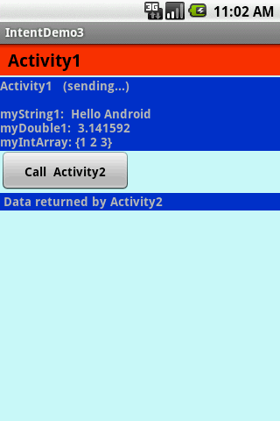
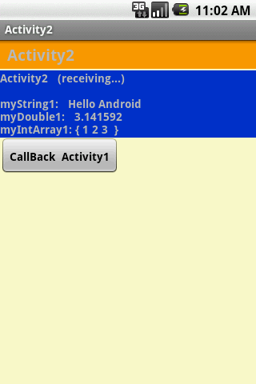
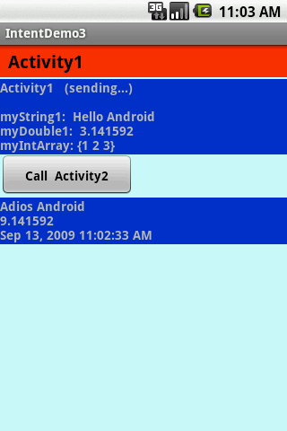
This example is similar to previous.
You may want to skip it.
12. Android – Intents – Part 2
Intents
Example: Activity1 invokes Activity2 using an Intent. A bundle containg a set of values is sent back-and-forth between both activities.
70

Slide 71
12. Android – Intents – Part 2
Intents
Example: Activity1 invokes Activity2 using an Intent. A bundle conating a set of values is sent back-and-forth between both activities (see 12IntentDemo3.zip).
//Activity1: Invoking a user-defined sub-activity
//sending and receiving results from the sub-activity
package cis493.intents;
import android.app.Activity;
import android.content.Intent;
import android.os.Bundle;
import android.view.View;
import android.view.View.OnClickListener;
import android.widget.*;
public class Activity1 extends Activity {
TextView label1;
TextView label1Returned;
Button btnCallActivity2;
private final int IPC_ID = 1122;
71

Slide 72
12. Android – Intents – Part 2
Intents
Example: Activity1 invokes Activity2 using an Intent. A bundle conating a set of values is sent back-and-forth between both activities.
@Override
public void onCreate(Bundle savedInstanceState) {
super.onCreate(savedInstanceState);
try {
setContentView(R.layout.main);
label1 = (TextView) findViewById(R.id.label1);
label1Returned = (TextView) findViewById(R.id.label1Returned);
btnCallActivity2 = (Button) findViewById(R.id.btnCallActivity2);
btnCallActivity2.setOnClickListener(new Clicker1());
// for demonstration purposes- show in top label
label1.setText("Activity1 (sending...) \n\n"
+ "myString1: Hello Android" + "\n"
+ "myDouble1: 3.141592 " + "\n"
+ "myIntArray: {1 2 3} ");
} catch (Exception e) {
Toast.makeText(getBaseContext(),
e.getMessage(), Toast.LENGTH_LONG).show();
}
}// onCreate
72

Slide 73
12. Android – Intents – Part 2
Intents
Example: Activity1 invokes Activity2 using an Intent. A bundle conating a set of values is sent back-and-forth between both activities.
private class Clicker1 implements OnClickListener {
@Override
public void onClick(View v) {
try {
// create an Intent to talk to Activity2
Intent myIntentA1A2 = new Intent(Activity1.this, Activity2.class);
// prepare a Bundle and add the data pieces to be sent
Bundle myData = new Bundle();
myData.putString("myString1", "Hello Android");
myData.putDouble("myDouble1", 3.141592);
int[] myLittleArray = { 1, 2, 3 };
myData.putIntArray("myIntArray1", myLittleArray);
// bind the Bundle and the Intent that talks to Activity2
myIntentA1A2.putExtras(myData);
// call Activity2 and wait for results
startActivityForResult(myIntentA1A2, IPC_ID);
} catch (Exception e) {
Toast.makeText(getBaseContext(), e.getMessage(),Toast.LENGTH_LONG).show();
}
}// onClick
}// Clicker1
73

Slide 74
12. Android – Intents – Part 2
Intents
Example: Activity1 invokes Activity2 using an Intent. A bundle conating a set of values is sent back-and-forth between both activities.
@Override
protected void onActivityResult(int requestCode, int resultCode, Intent data) {
super.onActivityResult(requestCode, resultCode, data);
try {
switch (requestCode) {
case IPC_ID: {
//OK. This is the place to process the results sent back from the subactivity
//see next slide
} else {
// user pressed the BACK button
label1.setText("Selection CANCELLED!");
}// if
break;
}// case
}// switch
} catch (Exception e) {
Toast.makeText(getBaseContext(), e.getMessage(), Toast.LENGTH_LONG).show();
}// try
}// onActivityResult
}// AndroIntent1
74

Slide 75
12. Android – Intents – Part 2
Intents
Example: Activity1 invokes Activity2 using an Intent. A bundle conating a set of values is sent back-and-forth between both activities.
@Override
protected void onActivityResult(int requestCode, int resultCode, Intent data) {
super.onActivityResult(requestCode, resultCode, data);
try {
switch (requestCode) {
case IPC_ID: {
//OK. This is the place to process the results sent back from the sub-activity
//see next slide
} else {
// user pressed the BACK button
label1.setText("Selection CANCELLED!");
}// if
break;
}// case
}// switch
} catch (Exception e) {
Toast.makeText(getBaseContext(), e.getMessage(), Toast.LENGTH_LONG).show();
}// try
}// onActivityResult
}// AndroIntent1
75

Slide 76
12. Android – Intents – Part 2
Intents
Example: Activity1 invokes Activity2 using an Intent. A bundle conating a set of values is sent back-and-forth between both activities.
// Activity2 is over - see what happened
if (resultCode == Activity.RESULT_OK) {
// good! - we have some data sent back from Activity2
Bundle myReturnedData = data.getExtras();
String myReturnedString1 = myReturnedData.getString("myReturnedString1");
Double myReturnedDouble1 = myReturnedData.getDouble("myReturnedDouble1");
String myReturnedString2 = myReturnedData.getString("myCurrentTime");
// display in the bottom label
label1Returned.setText(myReturnedString1 + "\n"
+ Double.toString(myReturnedDouble1) + "\n"
+ myReturnedString2);
}
76

Slide 77
12. Android – Intents – Part 2
Intents
Example: Activity1 invokes Activity2 using an Intent. A bundle conating a set of values is sent back-and-forth between both activities.
// Activity2. This subactivity receives a bundle of data, performs some work on the data and,
// returns results to Activity1.
package cis493.intents;
import java.util.Date;
import android.app.Activity;
import android.content.Intent;
import android.os.Bundle;
import android.view.View;
import android.view.View.OnClickListener;
import android.widget.*;
public class Activity2 extends Activity {
TextView label2;
Button btnCallActivity1;
77

Slide 78
12. Android – Intents – Part 2
Intents
Example: Activity1 invokes Activity2 using an Intent. A bundle conating a set of values is sent back-and-forth between both activities.
// Activity2 – cont…
@Override
public void onCreate(Bundle savedInstanceState) {
super.onCreate(savedInstanceState);
setContentView(R.layout.main2);
//bind UI variables to Java code
label2 = (TextView)findViewById(R.id.label2);
btnCallActivity1 = (Button)findViewById(R.id.btnCallActivity1);
btnCallActivity1.setOnClickListener(new Clicker1());
//create a local Intent handler – we have been called!
Intent myLocalIntent = getIntent();
//grab the data package with all the pieces sent to us
Bundle myBundle = myLocalIntent.getExtras();
//extract the individual data parts of the bundle
String str1 = myBundle.getString("myString1");
double dob1 = myBundle.getDouble("myDouble1");
int[] arr1 = myBundle.getIntArray("myIntArray1");
78

Slide 79
12. Android – Intents – Part 2
Intents
Example: Activity1 invokes Activity2 using an Intent. A bundle conating a set of values is sent back-and-forth between both activities.
//Activity2 – cont…
//do something with the data here (for example...)
String strArr = "{ ";
int sumIntValues = 0;
for (int i=0; i<arr1.length; i++) {
sumIntValues += arr1[i];
strArr += Integer.toString( arr1[i] ) + " ";
}
strArr += " }";
//show arriving data in GUI label
label2.setText("Activity2 (receiving...) \n\n" + "myString1: " + str1 + "\n" +
"myDouble1: " + Double.toString(dob1) + "\n" + "myIntArray1: " + strArr);
//now go back to myActivity1 with some data made here
double someNumber = sumIntValues + dob1;
myBundle.putString("myReturnedString1", "Adios Android");
myBundle.putDouble("myReturnedDouble1", someNumber);
myBundle.putString("myCurrentTime", new Date().toLocaleString() );
myLocalIntent.putExtras(myBundle);
setResult(Activity.RESULT_OK, myLocalIntent);
}//onCreate());
79

Slide 80
12. Android – Intents – Part 2
Intents
Example: Activity1 invokes Activity2 using an Intent. A bundle conating a set of values is sent back-and-forth between both activities.
Layout main.xml
<?xml version="1.0" encoding="utf-8"?>
<LinearLayout
android:id="@+id/linLayout"
android:layout_width="fill_parent"
android:layout_height="fill_parent"
android:background="#ffccffff"
android:orientation="vertical"
xmlns:android="http://schemas.android.com/apk/res/android"
>
<TextView
android:id="@+id/caption1"
android:layout_width="fill_parent"
android:layout_height="wrap_content"
android:background="#ffff3300"
android:padding="4sp"
android:text=" Activity1 "
android:textSize="20px"
android:textStyle="bold"
android:textColor="#ff000000"
>
</TextView>
<TextView
android:id="@+id/widget107"
android:layout_width="fill_parent"
android:layout_height="2sp"
>
</TextView>
<TextView
android:id="@+id/label1"
android:layout_width="fill_parent"
android:layout_height="wrap_content"
android:background="#ff0033cc"
android:text="Data to be sent to SubActivity:"
android:textStyle="bold"
>
</TextView>
<Button
android:id="@+id/btnCallActivity2"
android:layout_width="149px"
android:layout_height="wrap_content"
android:padding="6sp"
android:text="Call Activity2"
android:textStyle="bold"
>
</Button>
<TextView
android:id="@+id/label1Returned"
android:layout_width="fill_parent"
android:layout_height="wrap_content"
android:background="#ff0033cc"
android:text=" Data returned by Activity2"
android:textStyle="bold"
>
</TextView>
</LinearLayout>
80

Slide 81
12. Android – Intents – Part 2
Intents
Example: Activity1 invokes Activity2 using an Intent. A bundle conating a set of values is sent back-and-forth between both activities.
Layout main2.xml
<?xml version="1.0" encoding="utf-8"?>
<LinearLayout
android:id="@+id/linearLayout"
android:layout_width="fill_parent"
android:layout_height="fill_parent"
android:background="#ffffffcc"
android:orientation="vertical"
xmlns:android="http://schemas.android.com/apk/res/android"
>
<TextView
android:layout_width="fill_parent"
android:layout_height="wrap_content"
android:background="#ffff9900"
android:padding="4sp"
android:text=" Activity2"
android:textSize="20px"
android:textStyle="bold"
>
</TextView>
<TextView
android:id="@+id/widget107"
android:layout_width="fill_parent"
android:layout_height="2sp"
>
</TextView>
<TextView
android:id="@+id/label2"
android:layout_width="fill_parent"
android:layout_height="wrap_content"
android:background="#ff0033cc"
android:text="Data Received from Activity1 ..."
android:textStyle="bold"
>
</TextView>
<Button
android:id="@+id/btnCallActivity1"
android:layout_width="149px"
android:layout_height="wrap_content"
android:padding="6sp"
android:text="CallBack Activity1"
android:textStyle="bold"
>
</Button>
</LinearLayout>
81

Slide 82
Android Location Based Services
24
Notes are based on:
Android Developers
http://developer.android.com/index.html

Slide 83
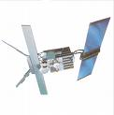
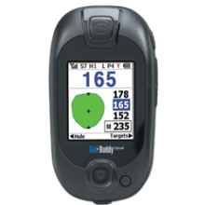
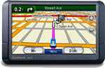

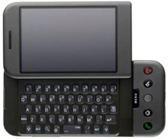
24. Android - Location Services
Location Services
Introduction
A location-based service (LBS) is an information dissemination system that can be accessed by mobile devices through the mobile network. It is driven by the ability of the system to detect the geographical position of the mobile device.
83
83
83

Slide 84
24. Android - Location Services
Location Services
Introduction
Location Based Services are used in a variety of situations, such as
commercial,
entertainment,
emergency,
health,
work,
personal life, etc.
Examples:
Locate the nearest bank, restaurant, gas station, hotel, golf course, hospital, police station, etc.
Provide transportation information on how to go from ‘here’ to ‘there’.
Social networking is used to locate and reach events, friends and family members.
84
84
84

Slide 85
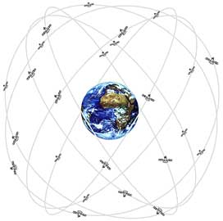
24. Android - Location Services
Location Services
How the Global Positioning System (GPS) Works?
The Global Positioning System (GPS) consists of
27 Earth-orbiting satellites (24 in operation and
three extras in case one fails).
Developed by the USA as a military navigation
system, but soon it opened to other civilian uses.
Each of these 3,000- to 4,000-pound solar-powered satellites circles the globe at about 12,000 miles (19,300 km), making two complete rotations every day.
The orbits are arranged so that at any time, anywhere on Earth, there are at least four satellites "visible" in the sky.
A GPS receiver's job is to locate three or more of these satellites, figure out the distance to each, and use this information to deduce its own location. This operation is based on a mathematical principle called trilateration.
85
85
Reference: http://electronics.howstuffworks.com/gadgets/travel/gps.htm
85

Slide 86
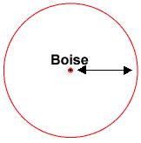
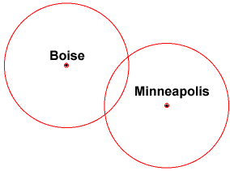
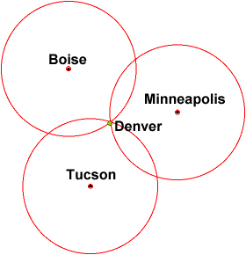
24. Android - Location Services
Location Services
How the Global Positioning System (GPS) Works?
2-D Trilateration
Imagine you are somewhere in the United States and you are TOTALLY lost -- for whatever reason, you have absolutely no clue where you are. You find a friendly local and ask, "Where am I?" He says, "You are 625 miles from Boise, Idaho.“
You ask somebody else where you are, and she says, "You are 690 miles from Minneapolis, Minnesota." Now you have two circles that intersect. You now know that you must be at one of these two intersection points.
If a third person tells you that you are 615 miles from Tucson, Arizona, you can eliminate one of the possibilities. You now know exactly
where you are -- Denver, Colorado.
This same concept works in three-dimensional space, as well,
but you're dealing with spheres instead of circles.
86
86
Reference: http://electronics.howstuffworks.com/gadgets/travel/gps.htm
86

Slide 87

24. Android - Location Services
Location Services
How the Global Positioning System (GPS) Works? / Trilateration
--- Miami 1795 km
--- Caracas 1874 km
--- Bogota 1251 km
San Jose, CR
87
87
87

Slide 88


24. Android - Location Services
Location Services
3D-Trilateration
Rather than circles three spheres intersect to define your GPS receiver’s location.
For a visual explanation visit: http://electronics.howstuffworks.com/gadgets/travel/gps.htm
88
88
Reference: http://electronics.howstuffworks.com/gadgets/travel/gps.htm
88

Slide 89


24. Android - Location Services
Location Services
3D-Trilateration
Rather than circles three spheres intersect to define your GPS receiver’s location.
For a visual explanation visit: http://electronics.howstuffworks.com/gadgets/travel/gps.htm
89
89
Reference: http://electronics.howstuffworks.com/gadgets/travel/gps.htm
89

Slide 90


24. Android - Location Services
Location Services
3D-Trilateration
Rather than circles three spheres intersect to define your GPS receiver’s location.
For a visual explanation visit: http://electronics.howstuffworks.com/gadgets/travel/gps.htm
90
90
Reference: http://electronics.howstuffworks.com/gadgets/travel/gps.htm
90

Slide 91

24. Android - Location Services
Location Services
Cell Tower Triangulation
An alternative method to determine the location of a cell phone is to estimate its distance to three nearby cell towers.
Distance of the phone to each antenna
could be estimated based upon the
lag time between the moment the
tower sends a ping to the phone and
receives the answering ping back.
Quite similar to the 2D-Trilateration
Method.
91
91
Reference: http://searchengineland.com/cell-phone-triangulation-accuracy-is-all-over-the-map-14790
91

Slide 92

24. Android - Location Services
Location Services
Latitude & Longitude
Latitude in GPS-Decimal notation: +90.00000 (North) to -90.000000 (South)
Longitude GPS-Decimal notation: +180.000000 (East) to -180.000000 (West)
92
92
92

Slide 93

24. Android - Location Services
Location Services
Android Location Classes
The Android API provides Location data based on a variety of methods including: Cell Tower Triangulation, and most commonly GPS chip readings.
GPS is the most common location provider on the Android based phones.
It offers the most accuracy.
Picture: Epson Infineon GPS (2.8 x 2.9mm)
Reference: http://gizmodo.com/5152146/
93
93
93

Slide 94
24. Android - Location Services
Location Services
Android Location Classes
Address | A class representing an Address, i.e, a set of strings describing a location.
Criteria | A class indicating the application criteria for selecting a location provider.
Geocoder | A class for handling geocoding.
GpsSatellite | This class represents the current state of a GPS satellite.
GpsStatus | This class represents the current state of the GPS engine.
Location | A class representing a geographic location sensed at a particular time (a "fix").
LocationManager | This class provides access to the system location services.
LocationProvider | An abstract superclass for location providers
94
94
94

Slide 95
24. Android - Location Services
Location Services
Android Location Interfaces
GpsStatus.Listener | Used for receiving notifications when GPS status has changed.
GpsStatus.NmeaListener | Used for receiving NMEA sentences from the GPS.
LocationListener | Used for receiving notifications from the LocationManager when the location has changed.
95
95
95

Slide 96
24. Android - Location Services
Location Services
Location Class
A class representing a geographic location sensed at a particular time (a "fix").
A location consists of a latitude and longitude, a UTC timestamp and optionally information on altitude, speed, and bearing.
Information specific to a particular provider or class of providers may be communicated to the application using getExtras, which returns a Bundle of key/value pairs.
Each provider will only provide those entries for which information is available.
CONSTANTS
Location.FORMAT_DEGREES | Constant used to specify formatting of a latitude or longitude in the form [+-]DDD.DDDDD where D indicates degrees.
Location.FORMAT_MINUTES | Constant used to specify formatting of a latitude or longitude in the form "[+-]DDD:MM.MMMMM" where D indicates degrees and M indicates minutes of arc (1 minute = 1/60th of a degree).
Location.FORMAT_SECONDS | Constant used to specify formatting of a latitude or longitude in the form “[+-] DDD:MM:SS.SSSSS" where D indicates degrees, M indicates minutes of arc, and S indicates seconds of arc (1 minute = 1/60th of a degree, 1 second = 1/3600th of a degree).
96
96
96

Slide 97
24. Android - Location Services
Location Services
Location Class – Useful Methods
static void | distanceBetween (double startLatitude, double startLongitude, double endLatitude, double endLongitude, float[] results) Computes the approximate distance in meters between two locations, and optionally the initial and final bearings of the shortest path between them.
float | getAccuracy () Returns the accuracy of the fix in meters.
double | getAltitude () Returns the altitude of this fix.
float | getBearing () Returns the direction of travel in degrees East of true North.
Bundle | getExtras () Returns additional provider-specific information about the location fix as a Bundle.
double | getLatitude () Returns the latitude of this fix.
double | getLongitude () Returns the longitude of this fix.
String | getProvider () Returns the name of the provider that generated this fix, or null if it is not associated with a provider.
float | getSpeed () Returns the speed of the device over ground in meters/second.
long | getTime () Returns the UTC time of this fix, in milliseconds since January 1, 1970.
97
97
97

Slide 98
24. Android - Location Services
Location Services
Location Manager
This class provides access to the system location services.
These services allow applications
To obtain periodic updates of the device's geographical location,
or to fire an application-specified Intent when the
device enters the proximity of a given geographical location.
You do not instantiate this class directly; instead, retrieve it through
Context.getSystemService (Context.LOCATION_SERVICE)
98
98
98

Slide 99
24. Android - Location Services
Location Services
Location Manager – Useful Methods
void | addProximityAlert (double latitude, double longitude, float radius, long expiration, PendingIntent intent) Sets a proximity alert for the location given by the position (latitude, longitude) and the given radius.
String | getBestProvider (Criteria criteria, boolean enabledOnly) Returns the name of the provider that best meets the given criteria.
GpsStatus | getGpsStatus (GpsStatus status) Retrieves information about the current status of the GPS engine.
Location | getLastKnownLocation (String provider) Returns a Location indicating the data from the last known location fix obtained from the given provider.
LocationProvider | getProvider (String name) Returns information associated with the location provider of the given name, or null if no provider exists by that name.
List<String> | getProviders (Criteria criteria, boolean enabledOnly) Returns a list of the names of LocationProviders that satisfy the given criteria, or null if none do.
void | requestLocationUpdates (String provider, long minTime, float minDistance, PendingIntent intent) Registers the current activity to be notified periodically by the named provider.
void | requestLocationUpdates (String provider, long minTime, float minDistance, LocationListener listener) Registers the current activity to be notified periodically by the named provider.
void | setTestProviderStatus (String provider, int status, Bundle extras, long updateTime) Sets mock status values for the given provider.
99
99
99

Slide 100
24. Android - Location Services
Location Services
LocationListener Class
Used for receiving notifications from the LocationManager when the location has changed.
These methods are called if the LocationListener has been registered with the location manager service using the method:
requestLocationUpdates (Provider, minTime, minDistance, LocationListener)
100
100
100

Slide 101
24. Android - Location Services
Location Services
LocationListener Class – Useful Methods
abstract void | onLocationChanged (Location location) Called when the location has changed.
abstract void | onProviderDisabled (String provider) Called when the provider is disabled by the user.
abstract void | onProviderEnabled (String provider) Called when the provider is enabled by the user.
abstract void | onStatusChanged (String provider, int status, Bundle extras) Called when the provider status changes.
101
101
101

Slide 102
24. Android - Location Services
Location Services
Constants:
LocationProvider.AVAILABLE
LocationProvider.OUT_OF_SERVICE
LocationProvider.TEMPORARILY_UNAVAILABLE
LocationProvider Class
Public Methods
abstract int | getAccuracy() Returns a constant describing horizontal accuracy of this provider.
String | getName() Returns the name of this provider.
abstract int | getPowerRequirement() Returns the power requirement for this provider.
abstract boolean | hasMonetaryCost() true if the use of this provider may result in a monetary charge to the user, false if use is free.
boolean | meetsCriteria(Criteria criteria) Returns true if this provider meets the given criteria, false otherwise.
abstract boolean | requiresCell() true access to a cellular network (to make use of cell tower IDs) is needed, false otherwise.
abstract boolean | requiresNetwork() true if the provider requires access to a data network (e.g., the Internet), false otherwise.
abstract boolean | requiresSatellite() true if access to a satellite-based positioning system (e.g., GPS) is needed, false otherwise.
abstract boolean | supportsAltitude() Returns true if the provider is able to provide altitude information, false otherwise.
abstract boolean | supportsBearing() Returns true if the provider is able to provide bearing information, false otherwise.
abstract boolean | supportsSpeed() Returns true if the provider is able to provide speed information, false otherwise.
102
102
102
102

Slide 103
24. Android - Location Services
Location Services
LocationProvider Class
An abstract superclass for location providers.
A location provider supplies periodic reports on the geographical location of the device.
Each provider has a set of criteria under which it may be used; for example,
some providers require GPS hardware and visibility to a number of satellites; others require the use of the cellular radio,
or access to a specific carrier's network,
or access to the internet.
They may also have different battery consumption characteristics or monetary costs to the user.
The Criteria class allows providers to be selected based on user-specified criteria.
103
103
103
103

Slide 104
24. Android - Location Services
Location Services
Example – Obtain Location from GPS .
In this example we request GPS services and display latitude and longitude values on the UI. Additionally we deliver an SMS with this information.
Notes
Observe the GPS chip is not a synchronous device that will immediately respond to a
“give me a GPS reading” call.
In order to engineer a good solution that takes into account the potential delays in obtaining location data we place the UI in the main activity and the request for location call in a background service.
Remember the service runs in the same process space as the main activity, therefore for the sake of responsiveness we must place the logic for location data request in a separate parallel thread.
A thread (unlike an Activity) needs the presence of a Looper control to manage IPC message sending. This implies and additional Looper.prepare and Looper.loop methods surrounding the locationUpdate method.
104
104
104

Slide 105

24. Android - Location Services
Location Services
Example – Obtain Location from GPS
105
105
105

Slide 106



24. Android - Location Services
Location Services
Example – Obtain Location from GPS .
5556
Use the DDMS > Emulator Control panel to enter test data reflecting Latitude and Longitude.
Select emulator 5554.
Press the ‘Send’ button to transmit the data.
A text message will be sent to a second emulator (5556)
5554
106
106
106

Slide 107
24. Android - Location Services
Location Services
Example – Obtain Location from GPS .
Layout
<?xml version="1.0" encoding="utf-8"?>
<LinearLayout
android:id="@+id/widget32"
android:layout_width="fill_parent"
android:layout_height="fill_parent"
android:orientation="vertical"
xmlns:android="http://schemas.android.com/apk/res/android"
>
<EditText
android:id="@+id/txtMsg"
android:layout_width="fill_parent"
android:layout_height="120px"
android:textSize="12sp"
>
</EditText>
<Button
android:id="@+id/btnStopService"
android:layout_width="151px"
android:layout_height="wrap_content"
android:text="Stop Service"
>
</Button>
</LinearLayout>
107
107
107

Slide 108
24. Android - Location Services
Location Services
Example – Obtain Location from GPS .
Manifest
<?xml version="1.0" encoding="utf-8"?>
<manifest xmlns:android="http://schemas.android.com/apk/res/android"
package="cis493.mappinggps"
android:versionCode="1"
android:versionName="1.0">
<application
android:icon="@drawable/icon"
android:label="@string/app_name"
android:debuggable="true" >
<activity android:name=".MyGPS"
android:label="@string/app_name">
<intent-filter>
<action android:name="android.intent.action.MAIN" />
<category android:name="android.intent.category.LAUNCHER" />
</intent-filter>
</activity>
<service
android:name="MyGpsService">
</service>
</application>
<uses-sdk android:minSdkVersion="2" />
<uses-permission android:name="android.permission.SEND_SMS" />
<uses-permission android:name="android.permission.ACCESS_FINE_LOCATION" />
</manifest>
108
108
108

Slide 109
24. Android - Location Services
Location Services
Example – Obtain Location from GPS .
Main Activity: MyGPS
// Request GPS location, show lat & long, deliver a text-message
// Application logic and its BroadcastReceiver in the same class
package cis493.mappinggps;
import android.app.Activity;
import android.os.Bundle;
import android.content.BroadcastReceiver;
import android.content.ComponentName;
import android.content.Context;
import android.content.Intent;
import android.content.IntentFilter;
import android.telephony.gsm.SmsManager;
import android.util.Log;
import android.view.View;
import android.view.View.OnClickListener;
import android.widget.*;
109
109
109

Slide 110
24. Android - Location Services
Location Services
Example – Obtain Location from GPS .
Main Activity: MyGPS
public class MyGPS extends Activity {
Button btnStopService;
TextView txtMsg;
Intent intentMyService;
ComponentName service;
BroadcastReceiver receiver;
String GPS_FILTER = "cis493.action.GPS_LOCATION";
110
110
110

Slide 111
24. Android - Location Services
Location Services
Example – Obtain Location from GPS .
Main Activity: MyGPS
@Override
public void onCreate(Bundle savedInstanceState) {
super.onCreate(savedInstanceState);
setContentView(R.layout.main);
txtMsg = (TextView) findViewById(R.id.txtMsg);
// initiate the service
intentMyService = new Intent(this, MyGpsService.class);
service = startService(intentMyService);
txtMsg.setText("MyGpsService started - (see DDMS Log)");
// register & define filter for local listener
IntentFilter mainFilter = new IntentFilter(GPS_FILTER);
receiver = new MyMainLocalReceiver();
registerReceiver(receiver, mainFilter);
111
111
111

Slide 112
24. Android - Location Services
Location Services
Example – Obtain Location from GPS .
Main Activity: MyGPS
btnStopService = (Button) findViewById(R.id.btnStopService);
btnStopService.setOnClickListener(new OnClickListener() {
public void onClick(View v) {
try {
stopService(new Intent(intentMyService) );
txtMsg.setText("After stoping Service: \n" +
service.getClassName());
btnStopService.setText("Finished");
btnStopService.setClickable(false);
} catch (Exception e) {
Log.e("MYGPS", e.getMessage() );
}
}
});
}//onCreate
112
112
112

Slide 113
24. Android - Location Services
Location Services
Example – Obtain Location from GPS .
Main Activity: MyGPS
////////////////////////////////////////////////////////////////////////
@Override
protected void onDestroy() {
super.onDestroy();
try {
stopService(intentMyService);
unregisterReceiver(receiver);
} catch (Exception e) {
Log.e ("MAIN-DESTROY>>>", e.getMessage() );
}
Log.e ("MAIN-DESTROY>>>" , "Adios" );
}// onDestroy
113
113
113

Slide 114
24. Android - Location Services
Location Services
Example – Obtain Location from GPS .
Main Activity: MyGPS
//////////////////////////////////////////////////////////////////////
// local RECEIVER
private class MyMainLocalReceiver extends BroadcastReceiver {
@Override
public void onReceive(Context localContext, Intent callerIntent) {
double latitude = callerIntent.getDoubleExtra("latitude",-1);
double longitude = callerIntent.getDoubleExtra("longitude",-1);
Log.e ("MAIN>>>", Double.toString(latitude));
Log.e ("MAIN>>>", Double.toString(longitude));
String msg = " lat: " + Double.toString(latitude) + " "
+ " lon: " + Double.toString(longitude);
txtMsg.append("\n" + msg);
//testing the SMS-texting feature
texting(msg);
}
}//MyMainLocalReceiver
114
114
114

Slide 115
24. Android - Location Services
Location Services
Example – Obtain Location from GPS .
Main Activity: MyGPS
//////////////////////////////////////////////////////////////
// sending a TEXT MESSAGE
private void texting(String msg){
try {
SmsManager smsMgr = SmsManager.getDefault();
// Parameter of sendTextMessage are:
// destinationAddress, senderAddress,
// text, sentIntent, deliveryIntent)
//----------------------------------------------------------
smsMgr.sendTextMessage("5556", "5551234",
"Please meet me at: " + msg,
null, null);
} catch (Exception e) {
Toast.makeText(this, "texting\n" + e.getMessage(), 1).show();
}
}// texting
}//MyGPS
115
115
115

Slide 116
24. Android - Location Services
Location Services
Example – Obtain Location from GPS .
Main Activity: MyGpsService
// This is the GPS service. Requests location updates
// in a parallel thread. sends broadcast using filter.
package cis493.mappinggps;
import android.app.Service;
import android.content.Context;
import android.content.Intent;
import android.location.Location;
import android.location.LocationListener;
import android.location.LocationManager;
import android.os.Bundle;
import android.os.IBinder;
import android.os.Looper;
import android.util.Log;
import android.widget.Toast;
public class MyGpsService extends Service {
String GPS_FILTER = "cis493.action.GPS_LOCATION";
Thread triggerService;
LocationManager lm;
GPSListener myLocationListener;
boolean isRunning = true;
116
116
116

Slide 117
24. Android - Location Services
Location Services
Example – Obtain Location from GPS .
Main Activity: MyGpsService
@Override
public IBinder onBind(Intent arg0) {
return null;
}
@Override
public void onCreate() {
super.onCreate();
}
@Override
public void onStart(Intent intent, int startId) {
super.onStart(intent, startId);
Log.e("<<MyGpsService-onStart>>", "I am alive-GPS!");
// we place the slow work of the service in its own thread so the
// response we send our caller who run a "startService(...)" method
// gets a quick OK from us.
117
117
117

Slide 118
24. Android - Location Services
Location Services
Example – Obtain Location from GPS .
Main Activity: MyGpsServive
triggerService = new Thread(new Runnable() {
public void run() {
try {
Looper.prepare();
// try to get your GPS location using the LOCATION.SERVIVE provider
lm = (LocationManager) getSystemService(Context.LOCATION_SERVICE);
// This listener will catch and disseminate location updates
myLocationListener = new GPSListener();
long minTime = 10000; // frequency update: 10 seconds
float minDistance = 50; // frequency update: 50 meter
lm.requestLocationUpdates( //request GPS updates
LocationManager.GPS_PROVIDER,
minTime,
minDistance,
myLocationListener);
Looper.loop();
} catch (Exception e) {
Log.e("MYGPS", e.getMessage() );
}
}// run
});
triggerService.start();
}// onStart
118
118
118

Slide 119
24. Android - Location Services
Location Services
Example – Obtain Location from GPS .
Main Activity: MyGpsServive
/////////////////////////////////////////////////////////////////////////
// location listener becomes aware of the GPS data and sends a broadcast
private class GPSListener implements LocationListener {
public void onLocationChanged(Location location) {
//capture location data sent by current provider
double latitude = location.getLatitude();
double longitude = location.getLongitude();
//assemble data bundle to be broadcasted
Intent myFilteredResponse = new Intent(GPS_FILTER);
myFilteredResponse.putExtra("latitude", latitude);
myFilteredResponse.putExtra("longitude", longitude);
Log.e(">>GPS_Service<<", "Lat:" + latitude + " lon:" + longitude);
//send the location data out
sendBroadcast(myFilteredResponse);
}
119
119
119

Slide 120
24. Android - Location Services
Location Services
Example – Obtain Location from GPS .
Main Activity: MyGpsServive
public void onProviderDisabled(String provider) {
}
public void onProviderEnabled(String provider) {
}
public void onStatusChanged(String provider,
int status, Bundle extras) {
}
};//GPSListener class
}// MyService3
Part of the listener’s interface
120
120
120

Slide 121

24. Android - Location Services
Location Services
GeoCoding: From Street-Address to Coordinates
TODO
What is a GeoCoder?
Explain example 25-GeoPoints
Geocoder gc = new Geocoder (this);
// get decimal coordinates for up to 5 (best) matching locations
List<Address> lstFoundAddresses = gc.getFromLocationName (txtStreetAddress, 5);
121
121
121

Slide 122

24. Android - Location Services
Location Services
Reverse GeoCoding: From Coordinates to Street-Address
TODO
Explain example 25-GeoCoordinates
Geocoder gc = new Geocoder(context, Locale.US);
List<Address> streets = gc.getFromLocation (latitude, longitude, 1);
122
122
122

Slide 123

24. Android - Location Services
Location Services
Multiple Overlays – Normal & Long Tap
TODO
Explain example 25-MapCleveland
123
123
123

Slide 124
24. Android - Location Services
Location Services
JARGON:
Bearing
is the angle (East-ward) between a line connecting two points (source, destination) and a north-south line, or meridian.
NMEA (National Marine Electronics Association)
The NMEA 2000 standard contains the requirements for the minimum implementation of a serial-data communications network to interconnect marine electronic equipment onboard vessels. Equipment designed to this standard will have the ability to share data, including commands and status, with other compatible equipment over a single signaling channel. Reference: http://www.nmea.org/content/nmea_standards/white_papers.asp
UTC - Coordinated Universal Time
Is a time standard based on International Atomic Time (TAI) with leap seconds added at irregular intervals to compensate for the Earth's slowing rotation. Visit: http://www.time.gov/timezone.cgi?Eastern/d/-5/java
124
124

Slide 125

24. Android - Location Services
Location Services
Keyhole Markup Language
Use Eclipse’s DDMS > Emulator Control > KML tab to provide location data to your emulator using a KML file.
Example: File my_location_data.kml contains the following set of placemarks
<?xml version="1.0" encoding="UTF-8"?>
<kml xmlns="http://earth.google.com/kml/2.2">
<Placemark>
<name>Station 46027</name>
<description>Off the coast of Lake Earl</description>
<Point>
<coordinates>-124.38,41.85,0</coordinates>
</Point>
</Placemark>
<Placemark>
<name>Station 46020</name>
<description>Outside the Golden Gate</description>
<Point>
<coordinates>-122.83,37.75,0</coordinates>
</Point>
</Placemark>
<Placemark>
<name>Station 46222</name>
<description>San Pedro Channel</description>
<Point>
<coordinates>-118.31,33.61,0</coordinates>
</Point>
</Placemark>
</kml>
Example taken from:
Unlocking Android by F. Ableson et al. Manning Publications 2009,
ISBN 978-1-933988-67-
125
125

Slide 126
24. Android - Location Services
Location Services
Appendix: Skyhook Location Services
(Excerpts taken from www.skyhookwireless.com)
Skyhook's Core Engine is a software-only location system that quickly determines device location with 10 to 20 meter accuracy.
A mobile device with Skyhook's Core Engine collects raw data from each of the location sources (GPS, towers, wi-fi).
The Skyhook client then sends this data to the Location Server and a single location estimate is returned.
The client is optimized so that it communicates with the Location Server only when the location cannot be determined locally.
This behavior minimizes the user's data cost while maximizing battery life
126
126

Slide 127

24. Android - Location Services
Location Services
Appendix: Skyhook Location Services
(Excerpts taken from www.skyhookwireless.com)
127
127

Slide 128
24. Android - Location Services
Location Services
Appendix: Skyhook Location Services
(Excerpts taken from www.skyhookwireless.com)
Wi-Fi positioning performs best where GPS is weakest, in urban areas and indoors.
GPS provides highly accurate location results in "open sky" environments, like rural areas and on highways. But in urban areas and indoors, tall buildings and ceilings block GPS' view of satellites, resulting in serious performance deficiencies in time to first fix, accuracy and availability. GPS or A-GPS alone cannot provide fast and accurate location results in all environments.
Cell tower triangulation provides generalized location results with only 200 - 1000 meter accuracy. It serves as a coverage fallback when neither GPS nor Wi-Fi is available.
Skyhook maintains a worldwide database of cell tower locations, which increases Core Engine coverage area and helps improve GPS satellite acquisition time.
128
128

Slide 129


24. Android - Location Services
Location Services
Appendix: Skyhook Location Services
Example: Get coordinates and display a map showing current location.
129
129

Slide 130

24. Android - Location Services
Location Services
Appendix: Skyhook Location Services
Example: Get coordinates and display a map showing current location.
You need to download the Skyhook library WPSAPI.JAR
Modify app path to include it
130
130

Slide 131
24. Android - Location Services
Location Services
Appendix: Skyhook Location Services
Example: Get coordinates and display a map showing current location.
<?xml version="1.0" encoding="utf-8"?>
<LinearLayout xmlns:android="http://schemas.android.com/apk/res/android"
android:id="@+id/linearLayout01"
android:orientation="vertical"
android:layout_width="fill_parent"
android:layout_height="fill_parent"
>
<EditText
android:id="@+id/txtBox"
android:layout_width="fill_parent"
android:layout_height="wrap_content"
android:text="Skyhooking... wait"
/>
<Button
android:text="Show Map"
android:id="@+id/btnMap"
android:layout_width="wrap_content"
android:layout_height="wrap_content"
android:padding="10px" />
</LinearLayout>
LAYOUT
131
131

Slide 132
24. Android - Location Services
Location Services
Appendix: Skyhook Location Services
Example: Get coordinates and display a map showing current location.
<?xml version="1.0" encoding="utf-8"?>
<manifest xmlns:android="http://schemas.android.com/apk/res/android"
package="cis493.skyhooklocation"
android:versionCode="1"
android:versionName="1.0">
<application android:icon="@drawable/sym_action_map2"
android:label="@string/app_name">
<activity android:name=".Skyhook_Location"
android:label="@string/app_name"
android:screenOrientation="portrait"
android:configChanges="orientation|keyboardHidden" >
<intent-filter>
<action android:name="android.intent.action.MAIN" />
<category android:name="android.intent.category.LAUNCHER" />
</intent-filter>
</activity>
</application>
<uses-sdk android:minSdkVersion="4" />
<!-- used to communicate with Skyhook's servers -->
<uses-permission android:name="android.permission.INTERNET" />
<!-- enables WiFi, if disabled, for the duration of a location request -->
<uses-permission android:name="android.permission.CHANGE_WIFI_STATE" />
<!-- used to obtain information about the WiFi environment -->
<uses-permission android:name="android.permission.ACCESS_WIFI_STATE" />
<!-- used to obtain cell tower ID -->
<uses-permission android:name="android.permission.ACCESS_COARSE_LOCATION" />
<uses-permission android:name="android.permission.ACCESS_COARSE_UPDATES" />
<!-- used to access GPS location, for XPS functionality -->
<uses-permission android:name="android.permission.ACCESS_FINE_LOCATION" />
<uses-permission android:name="android.permission.WAKE_LOCK" />
</manifest>
MANIFEST
132
132

Slide 133
24. Android - Location Services
Location Services
Appendix: Skyhook Location Services
Example: Get coordinates and display a map showing current location.
Skyhook_Location
// SKYHOOK_LOCATION.JAVA
// ------------------------------------------------------------------------
// Using the SKYHOOK system to 'quickly' get a GPS fix
// information available at: www.skyhookwireless.com
//
// Victor Matos - Nov 29, 2010
// ------------------------------------------------------------------------
package cis493.skyhooklocation;
import java.text.DateFormat;
import java.text.SimpleDateFormat;
import java.util.Date;
import java.util.TimeZone;
import android.app.Activity;
import android.app.ProgressDialog;
import android.content.Intent;
import android.content.res.Configuration;
import android.net.Uri;
import android.os.Bundle;
import android.os.Handler;
import android.os.Message;
import android.util.Log;
import android.view.MotionEvent;
import android.view.View;
import android.view.View.OnClickListener;
import android.view.View.OnTouchListener;
import android.widget.Button;
import android.widget.EditText;
import android.widget.Toast;
import com.skyhookwireless.wps.*;
133
133

Slide 134
24. Android - Location Services
Location Services
Appendix: Skyhook Location Services
Example: Get coordinates and display a map showing current location.
Skyhook_Location
public class Skyhook_Location extends Activity {
EditText txtBox;
Button btnShowMap;
ProgressDialog dialog;
double latitude, longitude, accuracy;
String time, address, ipAddress;
int nap, ncell;
String result;
IPLocation ipLocation;
WPSLocation wpsLocation;
IPLocationCallback ipCallback;
WPSLocationCallback wpsCallback;
// ------------------------------------------------------------------------------
// boolean usingEmulator = true; // generate code for the EMULATOR
boolean usingEmulator = true; // generate code for the DEVICE
// ------------------------------------------------------------------------------
// This handler receives messages sent by the asynchronous getIPLocation or
// getWPSLocation methods. The SKYHOOK callback method waits for the GPS hardware,
// tower triangulation method, or IP mapping to obtain location data. Finally
// the fix is placed in the handler's message queue.
// ------------------------------------------------------------------------------
Handler handler = new Handler(){
134
134

Slide 135
24. Android - Location Services
Location Services
Appendix: Skyhook Location Services
Example: Get coordinates and display a map showing current location.
Skyhook_Location
@Override
public void handleMessage(Message msg) {
super.handleMessage(msg);
if ((msg.arg1 > 360) && (msg.arg2 > 360)) {
// error situation
Toast.makeText(getApplicationContext(),
"Problem obtaining location\try agai...", 1).show();
finish();
}
result = "Skyhook Emulator:" + usingEmulator + "\n\n";
if (msg.obj.getClass().equals(IPLocation.class)) {
ipLocation = (IPLocation)msg.obj;
latitude = ipLocation.getLatitude();
longitude = ipLocation.getLongitude();
// showing results
result += "Latitude: " + latitude + "\n" +
"Longitude: " + longitude + "\n" +
"Time: " + beautify(ipLocation.getTime()) + "\n" +
"IP: " + ipLocation.getIP() + "\n";
}
else {
wpsLocation = (WPSLocation)msg.obj;
latitude = wpsLocation.getLatitude();
longitude = wpsLocation.getLongitude();
// showing results
result += "Latitude: " + latitude + "\n" +
"Longitude: " + longitude + "\n" +
"Time: " + beautify(wpsLocation.getTime()) + "\n" +
"Address: \n" + wpsLocation.getStreetAddress() + "\n" +
135
135

Slide 136
24. Android - Location Services
Location Services
Appendix: Skyhook Location Services
Example: Get coordinates and display a map showing current location.
Skyhook_Location
"Accuracy (ft): " + wpsLocation.getHPE() + "\n" +
"Ncell: " + wpsLocation.getNCell() + "\n" +
"NAP: " + wpsLocation.getNAP() + "\n" ;
}
// show results in the text box
txtBox.setText(result);
//get rid of the circular progress bar
if (dialog.isShowing()) {
dialog.dismiss();
}
btnShowMap.setEnabled(true);
}
};// handler
/////////////////////////////////////////////////////////////////////////////
@Override
public void onCreate(Bundle savedInstanceState) {
super.onCreate(savedInstanceState);
setContentView(R.layout.main);
dialog = new ProgressDialog(this);
dialog.setMessage("Wait\ngetting your current location...");
dialog.show();
txtBox = (EditText)findViewById(R.id.txtBox);
136
136

Slide 137
24. Android - Location Services
Location Services
Appendix: Skyhook Location Services
Example: Get coordinates and display a map showing current location.
Skyhook_Location
txtBox.setOnTouchListener(new OnTouchListener() {
@Override
public boolean onTouch(View arg0, MotionEvent arg1) {
//TRUE to prevent virtual keyboard to be called
return true;
}
});
btnShowMap = (Button) findViewById(R.id.btnMap);
btnShowMap.setOnClickListener(new OnClickListener() {
@Override
public void onClick(View v) {
// show map centered around (latitude, longitude) just found
String geoPoint = "geo:" + latitude + "," + longitude + "?z=17";
Intent mapIntent = new Intent(Intent.ACTION_VIEW, Uri.parse(geoPoint));
startActivity(mapIntent);
}
});
btnShowMap.setEnabled(false);
//----------------------------------------------------------------------
// Create the authentication object
//----------------------------------------------------------------------
WPS wps = new WPS(getApplicationContext());
WPSAuthentication auth = new WPSAuthentication("v.matos", "csuohio");
Log.e("<<AUTHENTICATION>>", "after authentication...");
//----------------------------------------------------------------------
// Call the location function with a callback
// When using device G1 change to: getWPSLocation (usingEmulator = false)
// when using Emulator try: getIPLocation (usingEmulator = true)
//----------------------------------------------------------------------
137
137

Slide 138
24. Android - Location Services
Location Services
Appendix: Skyhook Location Services
Example: Get coordinates and display a map showing current location.
Skyhook_Location
if (usingEmulator) {
Log.e("<<MAIN GETLOCATION>>", "asking for IP services...");
ipCallback = (IPLocationCallback) new MyIPLocationCallback(handler);
wps.getIPLocation(auth,
WPSStreetAddressLookup.WPS_NO_STREET_ADDRESS_LOOKUP,
(IPLocationCallback) ipCallback);
}
else {
Log.e("<<MAIN GETLOCATION>>", "asking for WPS services...");
wpsCallback = (WPSLocationCallback) new MyWPSLocationCallback(handler);
wps.getLocation(auth,
//WPSStreetAddressLookup.WPS_NO_STREET_ADDRESS_LOOKUP,
WPSStreetAddressLookup.WPS_FULL_STREET_ADDRESS_LOOKUP,
(WPSLocationCallback) wpsCallback);
}
}//onCreate
138
138

Slide 139
24. Android - Location Services
Location Services
Appendix: Skyhook Location Services
Example: Get coordinates and display a map showing current location.
Skyhook_Location
// -----------------------------------------------------------------------------
private String beautify (double timeMillis){
String result = "";
DateFormat df = new SimpleDateFormat("HH ':' mm ':' ss ");
df.setTimeZone(TimeZone.getTimeZone("GMT-5"));
result = df.format(new Date((long) timeMillis));
int elapsed = (int) (System.currentTimeMillis() - timeMillis)/1000;
result += "\nElapsed Time: " + elapsed + " sec.";
return (result);
}
// -----------------------------------------------------------------------------
@Override
public void onConfigurationChanged(Configuration newConfig) {
super.onConfigurationChanged(newConfig);
// needed to stop restarting application when orientation
// changes (see manifest)
}
// -----------------------------------------------------------------------------
}//SkyhooDemo2
139
139

Slide 140
24. Android - Location Services
Location Services
Appendix: Skyhook Location Services
Example: Get coordinates and display a map showing current location.
MyWPSLocationCallback
package cis493.skyhooklocation;
import android.os.Handler;
import android.os.Message;
import android.util.Log;
import com.skyhookwireless.wps.WPSContinuation;
import com.skyhookwireless.wps.WPSLocation;
import com.skyhookwireless.wps.WPSReturnCode;
// working with a DEVICE such as G1 or NEXUS
public class MyWPSLocationCallback implements com.skyhookwireless.wps.WPSLocationCallback
{
Handler handler;
public MyWPSLocationCallback (Handler handler){
this.handler = handler;
}
// What the application should do after it's done
public void done()
{
// after done() returns, you can make more WPS calls.
Log.e("<<DONE>>", "adios");
}
// What the application should do if an error occurs
public WPSContinuation handleError(WPSReturnCode error)
{
//handleWPSError(error); // you'll implement handleWPSError()
Log.e("<<ERROR>>", "error in handleError " );
140
140

Slide 141
24. Android - Location Services
Location Services
Appendix: Skyhook Location Services
Example: Get coordinates and display a map showing current location.
MyWPSLocationCallback
Message msg = handler.obtainMessage();
msg.arg1 = 777; //out of the range 0..360
msg.arg2 = 888; //to be recognized as an error
handler.sendMessage(msg);
// To retry the location call on error use WPS_CONTINUE,
// otherwise return WPS_STOP
return WPSContinuation.WPS_STOP;
}
// ----------------------------------------------------------------------
public void handleWPSLocation(WPSLocation location) {
Log.e("<<WPS-LOCATION>>", "latitude: " + location.getLatitude());
Log.e("<<WPS-LOCATION>>", "longitude: " + location.getLongitude());
Log.e("<<WPS-LOCATION>>", "address: " + location.getStreetAddress());
Log.e("<<WPS-LOCATION>>", "time: " + location.getTime() );
Log.e("<<WPS-LOCATION>>", "altitude: " + location.getAltitude());
Log.e("<<WPS-LOCATION>>", "Ncell: " + location.getNCell());
Log.e("<<WPS-LOCATION>>", "accuracy: " + location.getHPE());
Message msg = handler.obtainMessage();
msg.obj = (WPSLocation)location;
handler.sendMessage(msg);
}
};
141
141

Slide 142
24. Android - Location Services
Location Services
Appendix: Skyhook Location Services
Example: Get coordinates and display a map showing current location.
MyIPLocationCallback
package cis493.skyhooklocation;
import android.os.Handler;
import android.os.Message;
import android.util.Log;
import com.skyhookwireless.wps.IPLocation;
import com.skyhookwireless.wps.WPSContinuation;
import com.skyhookwireless.wps.WPSReturnCode;
// working with EMULATOR
public class MyIPLocationCallback implements com.skyhookwireless.wps.IPLocationCallback
{
Handler handler;
public MyIPLocationCallback (Handler handler){
this.handler = handler;
}
// What the application should do after it's done
public void done()
{
// after done() returns, you can make more WPS calls.
Log.e("<<DONE>>", "adios");
}
// What the application should do if an error occurs
public WPSContinuation handleError(WPSReturnCode error)
{
//handleWPSError(error); // you'll implement handleWPSError()
Log.e("<<ERROR>>", "error in handleError " );
Message msg = handler.obtainMessage();
142
142

Slide 143
24. Android - Location Services
Location Services
Appendix: Skyhook Location Services
Example: Get coordinates and display a map showing current location.
MyIPLocationCallback
Message msg = handler.obtainMessage();
msg.arg1 = 777; //out of the range 0..360
msg.arg2 = 888; //to be recognized as an error
handler.sendMessage(msg);
// To retry the location call on error use WPS_CONTINUE,
// otherwise return WPS_STOP
return WPSContinuation.WPS_STOP;
}
// ----------------------------------------------------------------------
public void handleIPLocation(IPLocation location) {
Log.e("<<IP-LOCATION>>", "latitude: " + location.getLatitude());
Log.e("<<IP-LOCATION>>", "longitude: " + location.getLongitude());
Log.e("<<IP-LOCATION>>", "address: " + location.getStreetAddress());
Log.e("<<IP-LOCATION>>", "time: " + location.getTime() );
Log.e("<<IP-LOCATION>>", "altitude: " + location.getAltitude());
Log.e("<<IP-LOCATION>>", "IP: " + location.getIP() );
Message msg = handler.obtainMessage();
msg.obj = (IPLocation)location;
handler.sendMessage(msg);
}
};
143
143

Slide 144
Android Working with MapViews
25
Victor Matos
Cleveland State University
Notes are based on:
Android Developers
http://developer.android.com/index.html

Slide 145

25. Android - MapViews
MapViews
Google Maps External Library
Android uses the Google Maps External Library to add mapping capabilities to your applications.
Google Maps External Library includes the com.google.android.maps package. The classes of this package offer built-in downloading, rendering, and caching of Maps tiles, as well as a variety of display options and controls.
The key class in the Maps package is com.google.android.maps.MapView, a subclass of ViewGroup.
A MapView displays a map with data obtained from the Google Maps service.
When the MapView has focus, it will capture keypresses and touch gestures to pan and zoom the map automatically, including handling network requests for additional maps tiles. It also provides all of the UI elements necessary for users to control the map.
145
145
145

Slide 146


25. Android - MapViews
MapViews
Google Maps External Library
Road View
Aerial View
146
146
146

Slide 147
25. Android - MapViews
MapViews
Google Maps External Library
Your application can also use MapView class methods to control the MapView programmatically and draw a number of Overlay types on top of the map.
In general, the MapView class provides a wrapper around the Google Maps API that lets your application manipulate Google Maps data through class methods, and it lets you work with Maps data as you would other types of Views.
The Maps external library is not part of the standard Android library, so it may not be present on some compliant Android-powered devices.
By default the Android SDK includes the Google APIs add-on, which in turn includes the Maps external library.
147
147
147

Slide 148

25. Android - MapViews
MapViews
Google Maps External Library
Warning !!!
In order to display Google Maps data in a MapView, you must register with the Google Maps service and obtain a Maps API Key
(see Appendix A)
148
148
148

Slide 149

25. Android - MapViews
MapViews
Tutorial 1 – Hello, MapView
Reference: http://developer.android.com/guide/tutorials/views/hello-mapview.html
We'll create a simple Activity that can view and navigate a map. Then we will add some overlay items.
149
149
149

Slide 150

25. Android - MapViews
MapViews
Tutorial 1– Hello, MapView
Reference: http://developer.android.com/guide/tutorials/views/hello-mapview.html
Part 1. Basic Map
Start a new project/Activity called HelloMapView.
Because we're using the Google Maps library, which is not a part of the standard Android library, we need to declare it in the Android Manifest. Open the AndroidManifest.xml file and add the following as a child of the <application> element:
<uses-library android:name="com.google.android.maps" />
We also need access to the internet in order to retrieve the Google Maps tiles, so the application must request the INTERNET permissions. In the manifest file, add the following as a child of the <manifest> element:
<uses-permission android:name="android.permission.INTERNET" />
150
150
150

Slide 151
25. Android - MapViews
MapViews
Tutorial 1– Hello, MapView
Reference: http://developer.android.com/guide/tutorials/views/hello-mapview.html
4. Now open the main layout file for your project. Define a layout with a com.google.android.maps.MapView inside a RelativeLayout:
<?xml version="1.0" encoding="utf-8"?>
<RelativeLayout xmlns:android="http://schemas.android.com/apk/res/android" android:id="@+id/mainlayout" android:orientation="vertical" android:layout_width="fill_parent" android:layout_height="fill_parent">
<com.google.android.maps.MapView
android:id="@+id/mapview"
android:layout_width="fill_parent"
android:layout_height="fill_parent"
android:clickable="true"
android:apiKey="Your Maps API Key" />
</RelativeLayout>
151
151
151

Slide 152
25. Android - MapViews
MapViews
Tutorial 1– Hello, MapView
Reference: http://developer.android.com/guide/tutorials/views/hello-mapview.html
4. cont.
The clickable attribute defines whether you want to allow user-interaction with the map. In this case, we set it "true" so that the user can navigate.
The apiKey attribute holds the Google Maps API Key that proves your application and signer certificate has been registered with the Google Maps service.
Because MapView uses Google Maps data, this key is required in order to receive the map data, even while you are developing (see appendix A).
For the purpose of this tutorial, you should register with the fingerprint of the SDK debug certificate. Once you've acquired the Maps API Key, insert it for the apiKey value.
152
152
152

Slide 153
25. Android - MapViews
MapViews
Tutorial 1– Hello, MapView
Reference: http://developer.android.com/guide/tutorials/views/hello-mapview.html
Now open the HelloMapView.java file. For this Activity, we're going to extend the special sub-class of Activity called MapActivity, so change the class declaration to extend MapActicity, instead of Activity:
public class HelloMapView extends MapActivity {
The isRouteDisplayed() method is required, so add it inside the class:
@Override
protected boolean isRouteDisplayed() {
return false;
}
7. Now go back to the HelloMapView class. At the top of HelloMapView, instantiate a handles for the MapView and the Map controller.
MapView mapView;
MapController controller;
153
153
153

Slide 154
25. Android - MapViews
MapViews
Tutorial 1– Hello, MapView
Reference: http://developer.android.com/guide/tutorials/views/hello-mapview.html
Wire-up the XML layout widget and the Java controls.
public void onCreate(Bundle savedInstanceState) {
super.onCreate(savedInstanceState);
setContentView(R.layout.main);
MapView mapView;
mapView = (MapView) findViewById(R.id.mapview);
mapView.setBuiltInZoomControls(true);
GeoPoint point = new GeoPoint (25800000,-80266667); // Miami City
controller = map.getController();
controller.animateTo(point);
controller.setZoom(3);
}
154
154
154

Slide 155
25. Android - MapViews
MapViews
Tutorial 1– Hello, MapView
Reference: http://developer.android.com/guide/tutorials/views/hello-mapview.html
In the previous fragment the mapView is activated by the use of the built-in zoom facility (new feature). This zoom control will appear at the center-bottom of the screen each time the user taps on the screen, and will disappear a few seconds later.
The MapController method .animateTo(geoPoint) center the map on the given coordinates.
The zoom factor range is 1..17 (17 closest to the map).
Ready to run.
155
155
155

Slide 156



25. Android - MapViews
MapViews
Tutorial 1– Hello, MapView
Reference: http://developer.android.com/guide/tutorials/views/hello-mapview.html
Intial map After tapping and zooming in After panning to go South
156
156
156

Slide 157

25. Android - MapViews
MapViews
Tutorial 1– Hello, MapView Overlays
Reference: http://developer.android.com/guide/tutorials/views/hello-mapview.html
Part 2. Overlays
An Overlay is a transparent layer that can be super-imposed on top of a MapView. An Overlay may incorporate any number of drawable items.
In this portion of the Tutorial1 we will place two images of Android on top of the map close to San Jose Costa Rica and Cleveland Ohio.
Go back to the HelloMapView class.
Add a drawable to the res/drawable-hdpi folder. For instance, copy there the file
C:\android-sdk-windows\platforms\android-4\data\res\drawable\ic_launcher_android.png
Now we need to implement the HelloItemizedOverlay class.
157
157
157

Slide 158
25. Android - MapViews
MapViews
Tutorial 1– Hello, MapView Overlays
Reference: http://developer.android.com/guide/tutorials/views/hello-mapview.html
Part 2. Overlays - HelloItemizedOverlay
The ItemizedOverlay class, will manage a set of Overlay items for us.
Create a new Java class named HelloItemizedOverlay that implements ItemizedOverlay.
When using Eclipse, right-click the package name in the Eclipse Package Explorer, and select New > Class. Fill-in the Name field as HelloItemizedOverlay. For the Superclass, enter com.google.android.maps.ItemizedOverlay. Click the checkbox for Constructors from superclass. Click Finish.
First thing, we need an OverlayItem ArrayList, in which we'll put each of the OverlayItem objects we want on our map. Add this at the top of the HelloItemizedOverlay class:
private ArrayList<OverlayItem> mOverlays = new ArrayList<OverlayItem>();
158
158
158

Slide 159
25. Android - MapViews
MapViews
Tutorial 1– Hello, MapView Overlays
Reference: http://developer.android.com/guide/tutorials/views/hello-mapview.html
Part 2. Overlays - HelloItemizedOverlay
Add the following class variable to HelloItemizedOverlay class
Context MyAppContext;
The class constructor should be
public HelloItemizedOverlay(Drawable defaultMarker, Context appContext) {
super(boundCenterBottom(defaultMarker));
MyAppContext = appContext;
}
We want the marker’s center-point at the bottom of the image to be the point at
which it's attached to the map coordinates. MyAppContext is the application’s
context.
159
159
159

Slide 160
25. Android - MapViews
MapViews
Tutorial 1– Hello, MapView Overlays
Reference: http://developer.android.com/guide/tutorials/views/hello-mapview.html
Part 2. Overlays - HelloItemizedOverlay
Continue with the AddOverlay method. Each time a new drawable item is supplied to the list, we call the populate method which will read each of the OverlayItems and prepare them to be drawn.
x
public void addOverlay(OverlayItem overlay) {
mOverlays.add(overlay);
populate();
}
7. Replace the existing contents of the createItem method with a get() call to our ArrayList:
@Override
protected OverlayItem createItem(int i) {
return mOverlays.get(i);
}
160
160
160

Slide 161
25. Android - MapViews
MapViews
Tutorial 1– Hello, MapView Overlays
Reference: http://developer.android.com/guide/tutorials/views/hello-mapview.html
Part 2. Overlays - HelloItemizedOverlay
Replace the existing contents of the size method with a size request to our ArrayList:
@Override
public int size() {
return mOverlays.size();
}
Provide a method to attend the Tap event
@Override
protected boolean onTap(int itemIndex) {
Toast.makeText(MyAppContext,
mOverlays.get(itemIndex).getTitle().toString(), 1).show();
return super.onTap(itemIndex);
}
We are done with the HelloItemizedOverlay class
161
161
161

Slide 162
25. Android - MapViews
MapViews
Tutorial 1– Hello, MapView
Reference: http://developer.android.com/guide/tutorials/views/hello-mapview.html
Part 3. Overlays
Back to the HelloMap class.
First we need some more types. Add the following declarations at the top of the HelloMapView class:
List<Overlay> mapOverlays;
Drawable drawable;
HelloItemizedOverlay itemizedOverlay;
Now pick up where we left off in the onCreate() method. Instantiate the new fields:
mapOverlays = mapView.getOverlays();
drawable = this.getResources().getDrawable(R.drawable.androidmarker);
itemizedOverlay = new HelloItemizedOverlay(drawable, this);
________
Note. You may pick any drawable from your SDK folder, say C:\Android\platforms\android-1.6\data\res\drawable
162
162
162

Slide 163
25. Android - MapViews
MapViews
Tutorial 1– Hello, MapView
Reference: http://developer.android.com/guide/tutorials/views/hello-mapview.html
Part 3. Overlays
Back to the HelloMap class. Adding OverlayItems to the map
Add a GeoPoint/title representing the ‘Cleveland Ohio’ location
GeoPoint point1 = new GeoPoint(41501719,-81675140);
OverlayItem overlayitem = new OverlayItem(point1, "Hello from CSU Ohio", "");
itemizedOverlay.addOverlay(overlayitem);
mapOverlays.add(itemizedOverlay);
Add a second geoPoint/title representing ‘San Jose, Costa Rica’
GeoPoint point2 = new GeoPoint( 9933056,-84083056);
OverlayItem overlayitem2 = new OverlayItem(point2, "Hola desde San Jose, CR", "");
itemizedOverlay.addOverlay(overlayitem2);
mapOverlays.add(itemizedOverlay);
5. Ready to run
163
163
163

Slide 164
25. Android - MapViews
MapViews
Tutorial 2. Using Geocoder
Reference http://developer.android.com/reference/android/location/Geocoder.html
Geocoder Class
Geocoding is the process of transforming a street address or other description of a location into a (latitude, longitude) coordinate.
Reverse geocoding is the process of transforming a (latitude, longitude) coordinate into a (partial) address.
The amount of detail in a reverse geocoded location description may vary, for example one might contain the full street address of the closest building, while another might contain only a city name and postal code.
Geocoding
Address | Location
1860 East 18 Street Cleveland Ohio | Latitude: +41.5020952 Longitude: -81.6789717
164
164
164

Slide 165
25. Android - MapViews
MapViews
Tutorial 2. Using Geocoder
Geocoder Class
Public Methods
List<Address> | getFromLocation (double latitude, double longitude, int maxResults) Returns an array of Addresses that are known to describe the area immediately surrounding the given latitude and longitude.
List<Address> | getFromLocationName (String locationName, int maxResults, double lowerLeftLatitude, double lowerLeftLongitude, double upperRightLatitude, double upperRightLongitude) Returns an array of Addresses that are known to describe the named location, which may be a place name such as "Dalvik, Iceland", an address such as "1600 Amphitheatre Parkway, Mountain View, CA", an airport code such as "SFO", etc..
List<Address> | getFromLocationName (String locationName, int maxResults) Returns an array of Addresses that are known to describe the named location, which may be a place name such as "Dalvik, Iceland", an address such as "1600 Amphitheatre Parkway, Mountain View, CA", an airport code such as "SFO", etc..
165
165
165

Slide 166
25. Android - MapViews
MapViews
Tutorial 2. Using Geocoder
Address Class http://www.oasis-open.org and http://developer.android.com/reference/android/location/Address.html
A class representing an Address, i.e, a set of Strings describing a location.
The address format is a simplified version of xAL (eXtensible Address Language)
Useful Methods
getAddressLine(int index)
Returns a line of the address numbered by the given index (starting at 0), or null if no such line is present.
getAdminArea()
Returns the administrative area name of the address, for example, "CA", or null if it is unknown
getCountryCode()
Returns the country code of the address, for example "US", or null if it is unknown.
getCountryName()
Returns the localized country name of the address, for example "Iceland", or null if it is unknown.
getFeatureName()
Returns the feature name of the address, for example, "Golden Gate Bridge", or null if it is unknown
getLatitude()
Returns the latitude of the address if known.
getLocale()
Returns the Locale associated with this address.
getLongitude()
Returns the longitude of the address if known.
getMaxAddressLineIndex()
Returns the largest index currently in use to specify an address line.
166
166
166

Slide 167
25. Android - MapViews
MapViews
Tutorial 2. Using Geocoder
Address Class http://www.oasis-open.org
Useful Methods
getPhone()
Returns the phone number of the address if known, or null if it is unknown.
getPostalCode()
Returns the postal code of the address, for example "94110", or null if it is unknown.
getUrl()
Returns the public URL for the address if known, or null if it is unknown.
setAddressLine(int index, String line)
Sets the line of the address numbered by index (starting at 0) to the given String, which may be null.
setCountryCode(String countryCode)
Sets the country code of the address to the given String, which may be null.
setCountryName(String countryName)
Sets the country name of the address to the given String, which may be null.
setLatitude(double latitude)
Sets the latitude associated with this address.
setLongitude(double longitude)
Sets the longitude associated with this address.
setPhone(String phone)
Sets the phone number associated with this address.
toString()
Returns a string containing a concise, human-readable description of this object.
167
167
167

Slide 168
25. Android - MapViews
MapViews
Tutorial 2. Using Geocoder
Address Class http://www.oasis-open.org
Useful Methods
getPhone()
Returns the phone number of the address if known, or null if it is unknown.
getPostalCode()
Returns the postal code of the address, for example "94110", or null if it is unknown.
getUrl()
Returns the public URL for the address if known, or null if it is unknown.
setAddressLine(int index, String line)
Sets the line of the address numbered by index (starting at 0) to the given String, which may be null.
setCountryCode(String countryCode)
Sets the country code of the address to the given String, which may be null.
setCountryName(String countryName)
Sets the country name of the address to the given String, which may be null.
setLatitude(double latitude)
Sets the latitude associated with this address.
setLongitude(double longitude)
Sets the longitude associated with this address.
setPhone(String phone)
Sets the phone number associated with this address.
toString()
Returns a string containing a concise, human-readable description of this object.
168
168
168

Slide 169
25. Android - MapViews
MapViews
Tutorial 2. Using Geocoder
Address & GeoPoint
Geocoder locations are stored in microdegrees (10⁻⁶).
GeoPoint is an immutable class representing a pair of latitude and longitude, stored as integer numbers of microdegrees.
Remember to multiply by 1,000,000 to convert
From Address location to GeoPoint location.
Example:
Geocoder gc = new Geocoder(this);
List<Address> coordinates = gc.getFromLocationName(
“1860 East 18 Street Cleveland Ohio”, 3);
double myLat = coordinates(0).getLatitude() * 1000000;
double myLon = coordinates(0).getLongitude() * 1000000;
GeoPoint p = new GeoPoint ( (int) myLat, (int) myLon );
myLat: +41.5020952
myLon: -81.6789717
169
169
169

Slide 170


25. Android - MapViews
MapViews
Example 2 – Geocoder
In this example we will create an application that converts an address to its corresponding GeoPoint and displays the location on a Mapview.
In the case of multiple possible locations a list of addresses is provided
(TODO: show the list in a dialog box or list selector and allow the user to make her selection by clicking on the best choice. As an example try: “Main Ave. Ohio”
170
170
170

Slide 171

25. Android - MapViews
MapViews
Example 2 – Geocoder
<?xml version="1.0" encoding="utf-8"?>
<LinearLayout
android:layout_width="fill_parent"
android:layout_height="fill_parent"
android:orientation="vertical"
xmlns:android="http://schemas.android.com/apk/res/android"
>
<TextView
android:id="@+id/myCaption"
android:layout_width="wrap_content"
android:layout_height="wrap_content"
android:text="Address/Coordinates" />
<LinearLayout
android:layout_width="fill_parent"
android:layout_height="wrap_content"
android:orientation="horizontal" >
<EditText
android:id="@+id/myAddress"
android:layout_width="wrap_content"
android:layout_height="wrap_content"
android:layout_weight="2"
android:hint="Enter location (address)"
android:textSize="18sp" />
<Button
android:id="@+id/myBtnSearch"
android:layout_width="wrap_content"
android:layout_height="wrap_content"
android:padding="10px"
android:text="Go" />
</LinearLayout>
<com.google.android.maps.MapView
android:id="@+id/myMap"
android:apiKey="0SN3rTw6p317v08_uva72oCS_hgPTe92J2t_nwQ"
android:layout_width="fill_parent"
android:layout_height="wrap_content"
android:layout_weight="2"
android:clickable="true" />
</LinearLayout>
171
171
171

Slide 172
25. Android - MapViews
MapViews
Example 2 – Geocoder
<?xml version="1.0" encoding="utf-8"?>
<manifest xmlns:android="http://schemas.android.com/apk/res/android"
package="cis493.mapping"
android:versionCode="1"
android:versionName="1.0">
<!-- Permissions -->
<uses-permission android:name="android.permission.ACCESS_COARSE_LOCATION" />
<uses-permission android:name="android.permission.INTERNET" />
<uses-sdk android:minSdkVersion="4" />
<application android:icon="@drawable/icon" android:label="@string/app_name">
<uses-library android:name="com.google.android.maps" />
<activity android:name=".GeopointDemo1"
android:label=".GeopointDemo1">
<intent-filter>
<action android:name="android.intent.action.MAIN" />
<category android:name="android.intent.category.LAUNCHER" />
</intent-filter>
</activity>
</application>
</manifest>
172
172
172

Slide 173
25. Android - MapViews
MapViews
Example 2 – Geocoder
// GeopointDemo1
// Enter address get location choices from a list
// show MapView location from last list entry
// ///////////////////////////////////////////////////////////////////
package cis493.mapping;
import java.util.List;
import android.app.AlertDialog;
import android.app.Dialog;
import android.location.Address;
import android.location.Geocoder;
import android.os.Bundle;
import android.util.Log;
import android.view.View;
import android.view.View.OnClickListener;
import android.widget.Button;
import android.widget.EditText;
import android.widget.Toast;
import com.google.android.maps.GeoPoint;
import com.google.android.maps.MapActivity;
import com.google.android.maps.MapController;
import com.google.android.maps.MapView;
173
173
173

Slide 174
25. Android - MapViews
MapViews
Example 2 – Geocoder
public class GeopointDemo1 extends MapActivity {
private MapView myMap;
private Button btnSearch;
private EditText address;
private Geocoder gc;
private double lat;
private double lon;
protected boolean isRouteDisplayed() {
return false;
}
@Override
public void onCreate(Bundle savedInstanceState) {
super.onCreate(savedInstanceState);
setContentView(R.layout.main);
Toast.makeText(this, "Try: MAIN AVE OHIO", 1).show();
//define handle to map and attach zooming[+ -] capabilities
myMap = (MapView) findViewById(R.id.myMap);
myMap.setBuiltInZoomControls(true);
gc = new Geocoder(this);
address = (EditText) findViewById(R.id.myAddress);
174
174
174

Slide 175
25. Android - MapViews
MapViews
Example 2 – Geocoder
btnSearch = (Button) findViewById(R.id.myBtnSearch);
btnSearch.setOnClickListener(new OnClickListener() {
public void onClick(View v) {
String addressInput = address.getText().toString(); // Get input text
try { // get up to 5 locations
List<Address> lstFoundAddresses = gc.getFromLocationName(
addressInput, 5);
if (lstFoundAddresses.size() == 0)
showInvalidAddressMsg();
else {
showListOfFoundAddresses(lstFoundAddresses);
//for now map the first address from the list
navigateToLocation(lstFoundAddresses.get(0), myMap);
}
} catch (Exception e) {
Toast.makeText(getBaseContext(), e.getMessage(), 1).show();
}
}// onClick
}); // btnSearch
}// onCreate
175
175
175

Slide 176
25. Android - MapViews
MapViews
Example 2 – Geocoder
// Navigates a given MapView to the specified Longitude and Latitude
public static void navigateToLocation(Address adr, MapView map) {
try {
//covert to integer representation of microdegrees
double latitude = adr.getLatitude() * 1000000;
double longitude = adr.getLongitude() * 1000000;
// new GeoPoint to be placed on the MapView
GeoPoint geoPt = new GeoPoint((int) latitude, (int) longitude);
MapController mapCtrl = map.getController();
mapCtrl.animateTo(geoPt); // move map to the given point
int maxZoomlevel = map.getMaxZoomLevel(); // detect maximum zoom level
int zoomapCtrlhosenLevel = (int) ((maxZoomlevel + 1)/1.25);
mapCtrl.setZoom(zoomapCtrlhosenLevel); // zoom at chosen level
mapCtrl.setCenter(geoPt); //center the map around the given address
map.setSatellite(false); // display only "normal road" mapview
map.setTraffic(false); // do not show traffic info
} catch (Exception e) {
Log.e("ERROR>>>", e.getMessage() );
}
}// navigateTo
176
176
176

Slide 177
25. Android - MapViews
MapViews
Example 2 – Geocoder
private void showInvalidAddressMsg() {
Dialog locationError = new AlertDialog.Builder( GeopointDemo1.this)
.setIcon(0)
.setTitle("Error")
.setPositiveButton("OK", null)
.setMessage("Sorry, your address doesn't exist.")
.create();
locationError.show();
}// showInvalidAddressMsg
private void showListOfFoundAddresses (List<Address> foundAddresses){
String msg = "";
for (int i = 0; i < foundAddresses.size(); ++i) {
// show results as address, Longitude and Latitude
// TODO: for multiple results show a select-list, try: MAIN AVE OHIO
Address a = foundAddresses.get(i);
lat = a.getLatitude();
lon = a.getLongitude();
String adr = "\n" + a.getAddressLine(0)
+ "\n" + a.getAddressLine(1);
msg += "\n" + i + " " + lat + " " + lon + adr;
Toast.makeText(getApplicationContext(), msg, 1).show();
}
}// showListOfFoundAddresses
}//class
177
177
177

Slide 178



25. Android - MapViews
MapViews
Example 2 – Geocoder
178
178
178

Slide 179


25. Android - MapViews
MapViews
Example 3 – More Overlays Cleveland Rocks
In this example we map downtown Cleveland placing markers on important places around the city’s downtown and the Euclid Corridor.
When the user taps on a marker a brief note with the name and description of the site appears, a long tap produces an invitation for a virtual tour of the site (to be done!)
179
179
179

Slide 180
25. Android - MapViews
MapViews
Example 2 – Geocoder
<?xml version="1.0" encoding="utf-8"?>
<RelativeLayout
xmlns:android="http://schemas.android.com/apk/res/android"
android:layout_width="fill_parent"
android:layout_height="fill_parent">
<com.google.android.maps.MapView
android:id="@+id/map"
android:layout_width="fill_parent"
android:layout_height="fill_parent"
android:apiKey="0SN3rTw6p317v08_uva72oCS_hgPTe92J2t_nwQ"
android:clickable="true" />
</RelativeLayout>
180
180
180

Slide 181
25. Android - MapViews
MapViews
Example 2 – Geocoder
<?xml version="1.0" encoding="utf-8"?>
<manifest xmlns:android="http://schemas.android.com/apk/res/android"
package="cis493.mapping"
android:versionCode="1"
android:versionName="1.0">
<!-- Permissions -->
<uses-permission android:name="android.permission.ACCESS_COARSE_LOCATION" />
<uses-permission android:name="android.permission.INTERNET" />
<uses-sdk android:minSdkVersion="4" />
<application android:icon="@drawable/icon" android:label="@string/app_name">
<uses-library android:name="com.google.android.maps" />
<activity android:name="ClevelandRocks"
android:label="Cleveland Rocks">
<intent-filter>
<action android:name="android.intent.action.MAIN" />
<category android:name="android.intent.category.LAUNCHER" />
</intent-filter>
</activity>
</application>
</manifest>
181
181
181

Slide 182
25. Android - MapViews
MapViews
Example 2 – Geocoder
package cis493.mapping;
// Mapping CLEVELAND DOWNTOWN - OHIO
// demonstrates SHORT & LONG TAP events
import android.content.res.Resources.NotFoundException;
import android.graphics.drawable.Drawable;
import android.graphics.Canvas;
import android.os.Bundle;
import android.view.KeyEvent;
import android.view.MotionEvent;
import android.widget.Toast;
import com.google.android.maps.GeoPoint;
import com.google.android.maps.ItemizedOverlay;
import com.google.android.maps.MapActivity;
import com.google.android.maps.MapView;
import com.google.android.maps.OverlayItem;
import java.util.ArrayList;
import java.util.List;
public class ClevelandRocks extends MapActivity {
// handle to the MapView
private MapView map = null;
//next two variables are part of a test for longPress event
private long lastTouchTimeDown = -1;
private long lastTouchTimeUp = -1;
182
182
182

Slide 183
25. Android - MapViews
MapViews
Example 2 – Geocoder
@Override
public void onCreate(Bundle savedInstanceState) {
super.onCreate(savedInstanceState);
setContentView(R.layout.main);
try {
map = (MapView) findViewById(R.id.map);
// place Terminal Tower at the Center of the map
map.getController().setCenter(getPoint(41.498370, -81.693883));
map.getController().setZoom(14); //range 1..21
map.setBuiltInZoomControls(true);
Drawable marker = getResources().getDrawable(R.drawable.marker);
marker.setBounds(0, 0,
marker.getIntrinsicWidth(),
marker.getIntrinsicHeight());
map.getOverlays().add (new SitesOverlay(marker));
map.setSatellite(false);
} catch (NotFoundException e) {
Toast.makeText(getApplicationContext(), e.getMessage(), 1).show();
}
}// onCreate
183
183
183

Slide 184
25. Android - MapViews
MapViews
Example 2 – Geocoder
@Override
public boolean onKeyDown(int keyCode, KeyEvent event) {
if (keyCode == KeyEvent.KEYCODE_S) {
map.setSatellite(!map.isSatellite());
return (true);
}
return (super.onKeyDown(keyCode, event));
}
private GeoPoint getPoint(double lat, double lon) {
return (new GeoPoint((int) (lat * 1000000.0), (int) (lon * 1000000.0)));
}
@Override
protected boolean isRouteDisplayed() {
return (false);
}
184
184
184

Slide 185
25. Android - MapViews
MapViews
Example 2 – Geocoder
/////////////////////////////////////////////////////////////////////////////////////////////////////
private class SitesOverlay extends ItemizedOverlay<OverlayItem> {
private List<OverlayItem> items = new ArrayList<OverlayItem>();
private Drawable marker = null;
public SitesOverlay(Drawable marker) {
super(marker);
this.marker = marker;
items.add (new OverlayItem(getPoint(41.498370,-81.693883),
"Terminal Tower", "AT the heart of the city"));
items.add (new OverlayItem(getPoint(41.506052,-81.699560),
"Cleveland Browns Stadium", "Football legends since 1946"));
items.add (new OverlayItem(getPoint(41.496550,-81.688198),
"Quicken Loans Arena", "Home of the Cleveland Cavaliers"));
items.add (new OverlayItem(getPoint(41.495749,-81.685333),
"Progressive Field", "Cleveland Indians Home\nMajor League Baseball since 1900's"));
items.add (new OverlayItem(getPoint(41.501719,-81.675140),
"Cleveland State University", "The People's University \nEngaged Learning"));
items.add (new OverlayItem(getPoint(41.502088,-81.623003),
"Cleveland Clinic", "Top Hospital & Medical Research in the USA"));
items.add (new OverlayItem(getPoint(41.506106,-81.609615),
"Severance Hall", "Cleveland Orchestra - Best in the World"));
items.add (new OverlayItem(getPoint(41.504223,-81.608512),
"Case Western Reserve Universty", "One of the Nation's Top Universities"));
items.add (new OverlayItem(getPoint(41.508968,-81.611754),
"Cleveland Museum of Art", "Most Distinguished \nOpen Museum in the World"));
items.add (new OverlayItem(getPoint(41.508421,-81.695540),
"Rock & Roll Hall of Fame", "Preserving for the world \nthe history of RR music"));
populate();
}
185
185
185

Slide 186
25. Android - MapViews
MapViews
Example 2 – Geocoder
@Override
protected OverlayItem createItem(int i) {
return (items.get(i));
}
@Override
public void draw(Canvas canvas, MapView mapView, boolean shadow) {
super.draw(canvas, mapView, shadow);
boundCenterBottom(marker);
}
@Override
protected boolean onTap(int i) {
// if time Difference between lastTouchTimeUp & lastTouchTimeDown is:
// > 1500 millisec. it was a LONG TAP
// < 1500 just a NORMAL tap
// on LONG TAPs we may want to show a dialog box with additional
// data about item i-th such as pictures, links to web-sites, ???, etc.
//---------------------------------------------------------------------
String text = "NORMAL TAP";
long pressTotalTime = lastTouchTimeUp - lastTouchTimeDown;
if (pressTotalTime > 1500) {
text = "LONG TAP";
}
Toast.makeText(getApplicationContext(), text + " " + pressTotalTime + " msec.\n" +
items.get(i).getTitle() + "\n" + items.get(i).getSnippet(), 1).show();
return (true);
}
186
186
186

Slide 187
25. Android - MapViews
MapViews
Example 2 – Geocoder
// TODO implement longPress actions (such as dialog box showing
// pictures, links, ???, of selected point.
@Override
public boolean onTouchEvent(MotionEvent event, MapView mapView) {
//remember the initial time the user touches the screen
if (event.getAction() == MotionEvent.ACTION_DOWN) {
lastTouchTimeDown = event.getDownTime();
lastTouchTimeDown = System.currentTimeMillis();
}
if (event.getAction() == MotionEvent.ACTION_UP) {
lastTouchTimeUp = System.currentTimeMillis();
}
return super.onTouchEvent(event, mapView);
}
@Override
public int size() {
return (items.size());
}
}// SitesOverlay
/////////////////////////////////////////////////////////////////////////////////////////
}//class
187
187
187

Slide 188
25. Android - MapViews
MapViews
Questions
188
188

Slide 189
25. Android - MapViews
MapViews
Appendix A:
Registering with Google Maps Services. See zipped file.
Appendix B.
Invoking Google Applications on Android Devices
http://developer.android.com/guide/appendix/g-app-intents.html
189
189

